Slide 2

Study of universal few-body states in ⁷Li - open answers to open questions, or everything I have learned on physics of ultracold lithium atoms.
(A technical discussion.)
Lev Khaykovich
Physics Department, Bar-Ilan University,
52900 Ramat Gan, Israel
Laboratoire Kastler Brossel, ENS,
24, rue Lhomond, 75231 Paris, Francs
LKB, ENS, Paris 7/12/2012

Slide 3
Outline
Brief introduction into Efimov scenario
    Experimental setup.
    Three-body recombination induced losses
    Feshbach resonances’ parameters
    Direct rf-association of Efimov trimers from a three-atom continuum
    Efimov resonances at the atom-dimer threshold
    Conclusions

Slide 4
Brief introduction into Efimov scenario

Slide 5
Efimov scenario – universality window
k
first excited
level
lowest
level
van der Waals range (⁷Li):

Slide 6
Efimov scenario – 3-body parameter
k
Position of an Efimov level is fixed by a 3-body parameter.

Slide 7
Experimental observables
k
One atom and a dimer
couple to an Efimov trimer
Three atoms couple
to an Efimov trimer
Experimental observable - enhanced three-body recombination.

Slide 8
Experimental observables
k
Two paths for the 3- body recombination
towards weakly bound state interfere destructively.
Experimental observable – recombination minimum.

Slide 9
Three-body recombination
Three body inelastic collisions result in a weakly (or deeply) bound molecule.
2E_{b}/3
E_{b}/3
Release of the binding energy causes loss which probes 3-body physics.
Loss rate from a trap:
K₃ – 3-body loss rate coefficient [cm⁶/sec]
Notes:
3 – the number of atoms lost per 3-body recombination. I hope to convince you that this is a wrong number in most cases for the large scattering length.

Slide 10
LO (universal) effective field theory for 3-body recombination
Positive scattering length side:
Loss into shallow dimer
Loss into deeply bound molecules
Negative scattering length side:
Braaten & Hammer, Phys. Rep. 428, 259 (2006)

Slide 11
Experimental setup

Slide 12
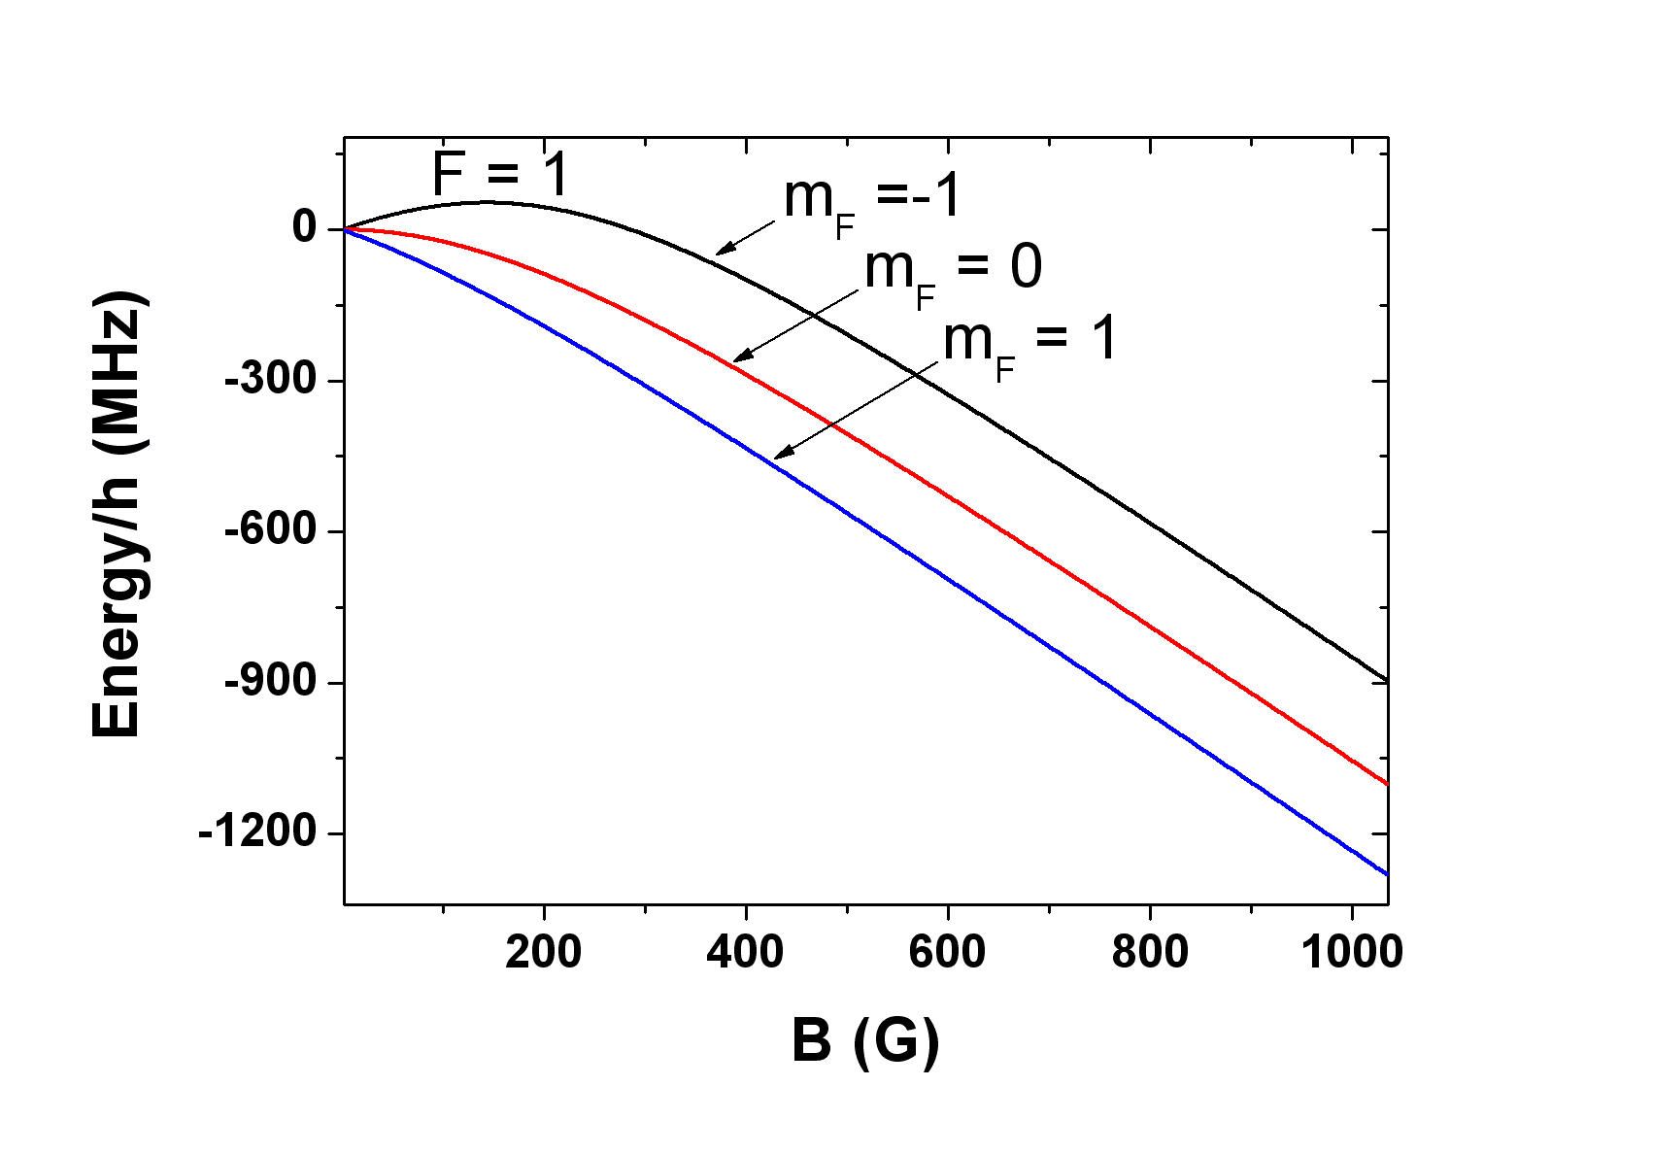
Experimental playground - ⁷Li
3 identical bosons on a single nuclear-spin state.
Absolute ground state
Next to the lowest Zeeman state

Slide 13
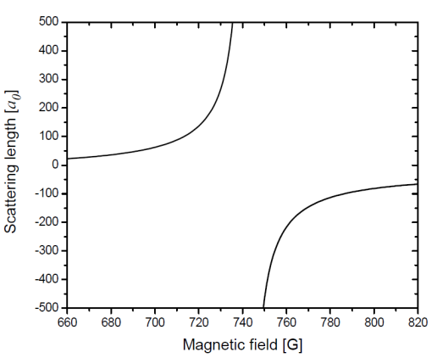
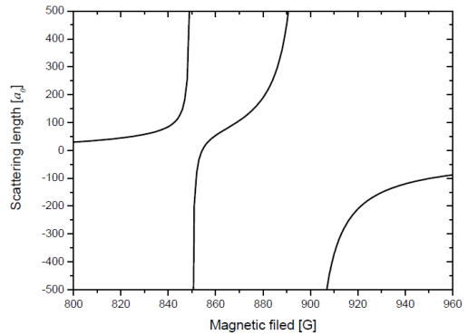
Experimental playground - ⁷Li
Absolute ground state
The one but lowest Zeeman state
Feshbach
resonance
Feshbach
resonance

Slide 14
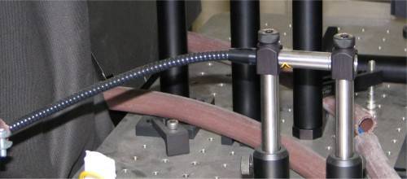
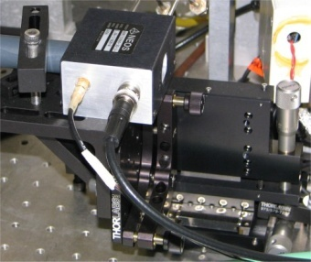
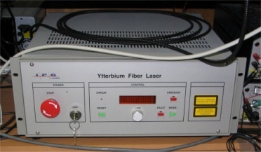
Experimental playground – dipole trap
Atoms are loaded into a dipole trap from MOT and optically pumped to F=1 state.
0 order (helping beam)
+1 order (main trap)
Ytterbium Fiber Laser
P = 100 W
w₀ = 31 μm
N=3x10⁴
T=1 μK
main trap
Θ = 19.5⁰
helping beam
w₀ = 40 μm
N. Gross and L. Khaykovich, PRA 77, 023604 (2008)

Slide 15
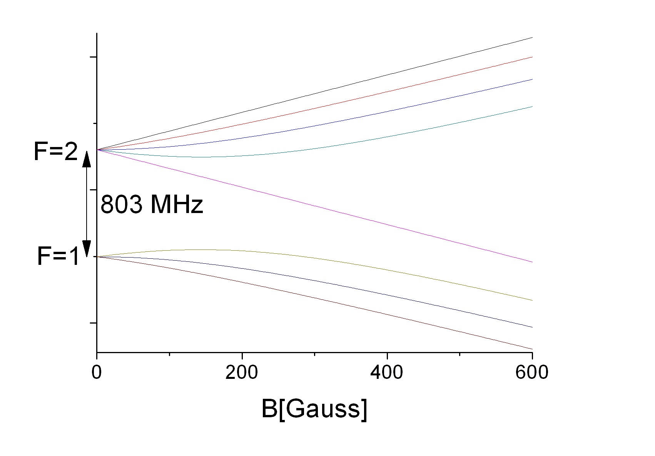
Feshbach resonances on F=1 state
Theory prediction for Feshbach resonances
S. Kokkelmans, unpublished

Slide 16
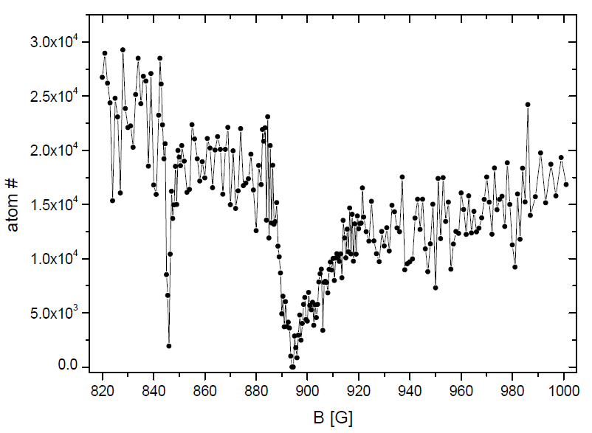
Search for Feshbach resonances
Atoms are loaded into a dipole trap and optically pumped to F=1 state.
Positions of Feshbach resonances from atom loss measurements:
Narrow resonance: 845.8(7) G
Wide resonance: 894.2(7) G
From the whole zoo of possible resonances only two were detected.

Slide 17
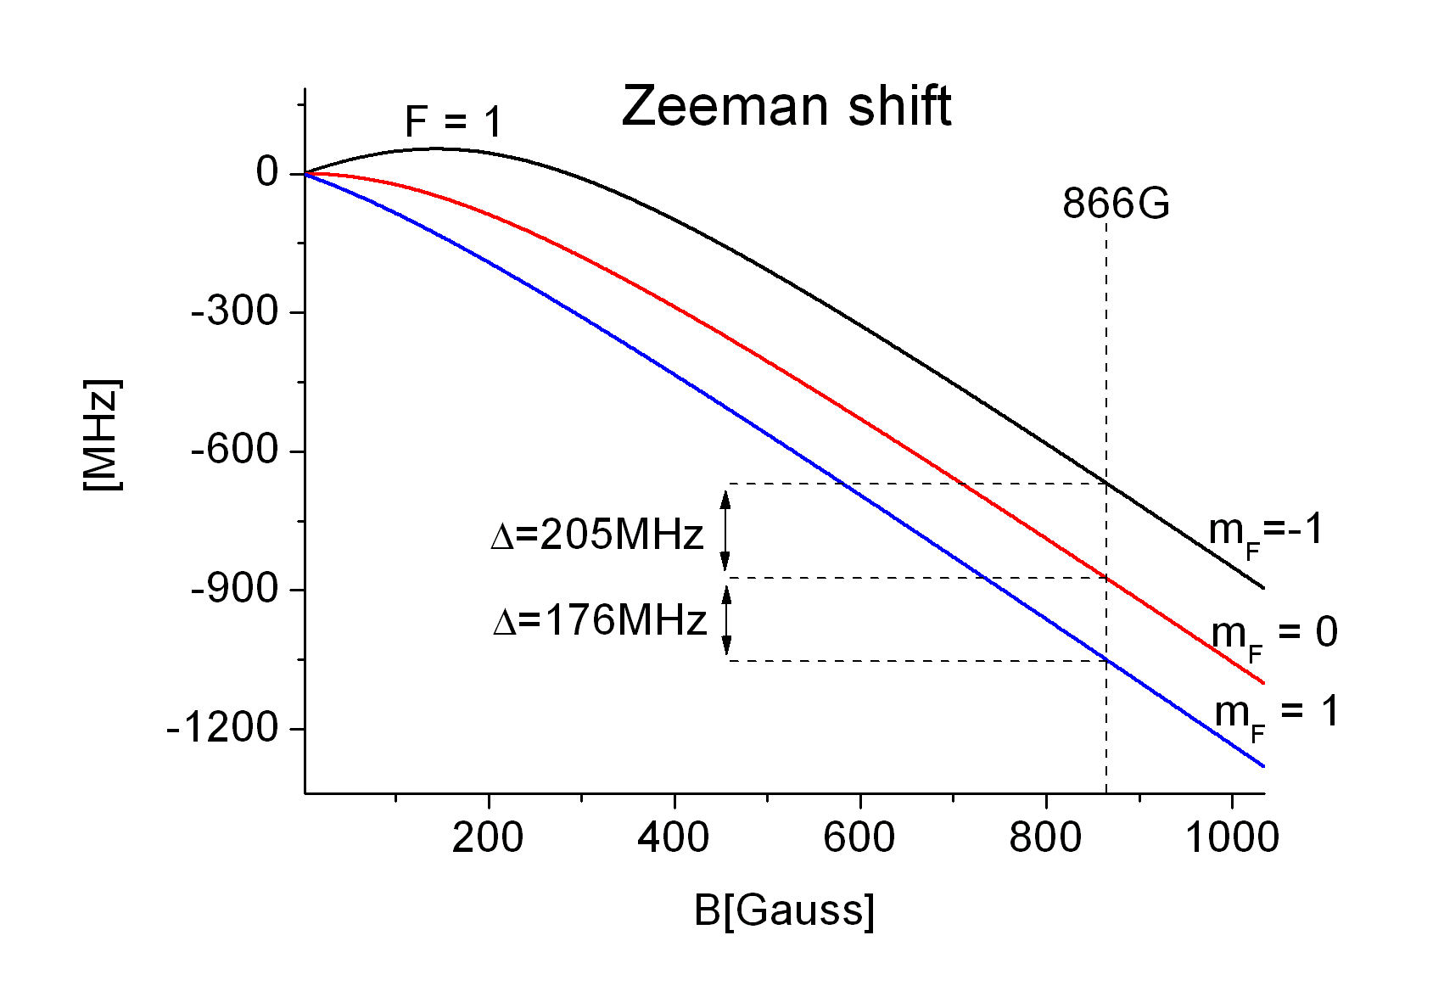
Spontaneous spin purification
With the spin selective measurement we identified that the atoms are in |F=1, m_{F}=0>
Spin-flip collisions
at high magnetic field:
N. Gross and L. Khaykovich, PRA 77, 023604 (2008)

Slide 18
three-body recombination induced losses

Slide 19
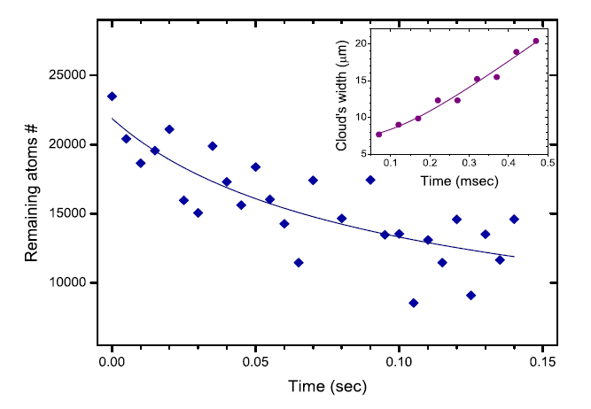
Three-body recombination
Typical set of measurements - atom number decay and temperature:
Loss rate from a trap:
K₃ – 3-body loss rate coefficient [cm⁶/sec]

Slide 20
Technical issues
Γ is determined independently by measuring a very long decay tail of a low density sample.
We exclude the temperature dependence (saturation) of K₃. We measure K₃ up to values which are at least an order of magnitude less than its estimated saturation value. Later fit (D. Petrov) to our data which included temperature dependence of K₃ showed negligible effect on extracted three-body parameters.
We neglect ‘anti-evaporation’ (an effective heating caused by preferential loss of atoms from the densest and thus coldest part of the atomic cloud). For that we treat our data only to no more than ~30% decrease in atom number for which ‘anti-evaporation’ is estimated to induce a systematic error of ~23% towards higher values of K₃.
We neglect recombination heating (an effective heating due to trapped products of the recombination process (positive scattering length where weakly bound dimers are allowed) . For that we are working in the regime where trap depth is always weak as compared to the energy released in the recombination process.
N. Gross, Z. Shotan, O. Machtey, S. Kokkelmans and L. Khaykovich, C.R. Physique 12, 4 (2011) ; arXiv:1009.0926

Slide 21
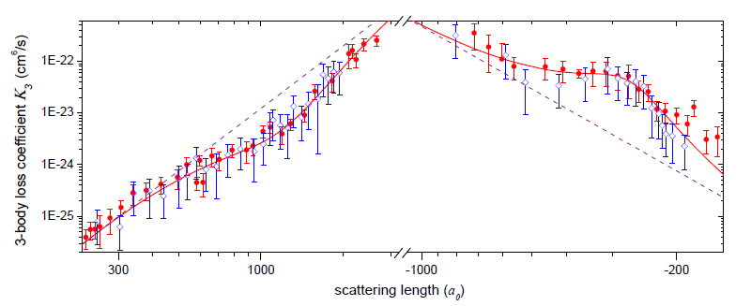
Three-body recombination
a > 0: T= 2 – 3 μK
a < 0: T= 1 – 2 μK
mf = 1; Feshbach resonance ~738G.
mf = 0; Feshbach resonance ~894G.
N. Gross, Z. Shotan, S. Kokkelmans and L. Khaykovich, PRL 103, 163202 (2009); PRL 105, 103203 (2010).

Slide 22
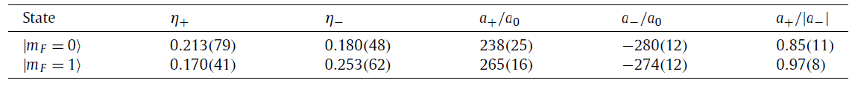
Summary of the results
Fitting parameters to the universal theory:
UT prediction:
a₊/|a₋| = 0.96(3)
Derived parameters:
Position of recombination minima:
Position of atom-dimer threshold:
3-body parameter is the same across the region of
3-body parameter is the same for both nuclear-spin subleves.
N. Gross, Z. Shotan, O. Machtey, S. Kokkelmans and L. Khaykovich, C.R. Physique 12, 4 (2011).
Notes:
If the 3-body parameter is assumed to be the same across the Feshabch resonance pole. 8.6 is probably because of intermidite Feshbach resonance.

Slide 23
Universality in the 3-body parameter (negative scattering lengths)

Slide 24
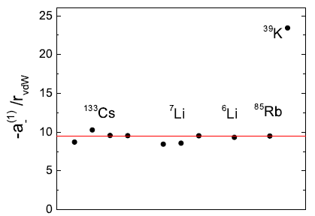
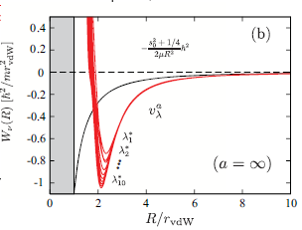
Universality of the 3-body parameter
C. Chin, arXiv:1111.1484.
Quantum reflection of the Efimov
wavefunction from the van der Waals potential.
J. Wang, J.P. D’Incao, B.D. Esry and C.H. Greene,
PRL 108, 263001 (2012).
A sharp cliff in the two-body interactions produces
a strongly repulsive barrier in the effective three-body
interaction potential.
(see also: P. Naidon, S. Endo and M. Ueda, arXiv:1208.3912).
More:
R. Scmidt, S.P. Rath and W. Zwerger, arXiv:1201.4310
P.K. Sorensen, D.V. Fedorov, A. Jensen and N.T. Zinner PRA 86, 052516 (2012).
Open question: two channel models does not seem to agree with the experimental data.

Slide 25
Feshbach resonances parameters

Slide 26

Rf association of universal dimers
k

Slide 27
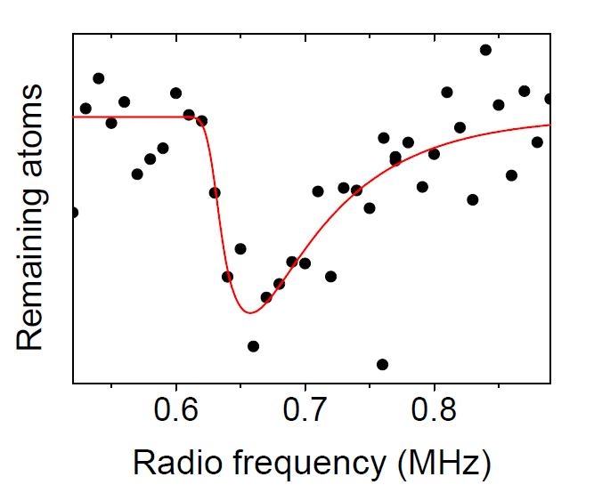
Rf association of universal dimers
Precise characterization of Feshbach resonances by rf-spectroscopy of universal dimers.
(RF modulation of the magnetic field bias).
A typical RF spectrum
N. Gross, Z. Shotan, O. Machtey, S. Kokkelmans and L. Khaykovich, C.R. Physique 12, 4 (2011) ; arXiv:1009.0926

Slide 28
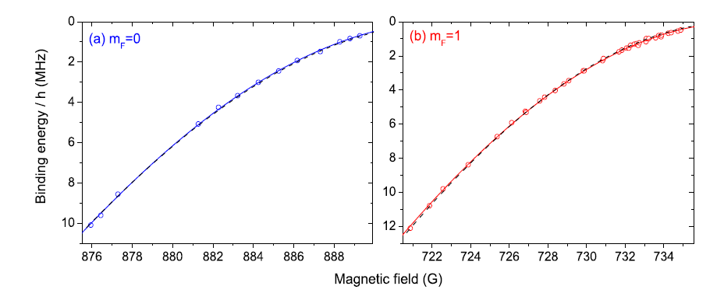
Rf association of universal dimers
Precise characterization of Feshbach resonances by rf-spectroscopy of universal dimers.
N. Gross, Z. Shotan, O. Machtey, S. Kokkelmans and L. Khaykovich, C.R. Physique 12, 4 (2011) ; arXiv:1009.0926

Slide 29
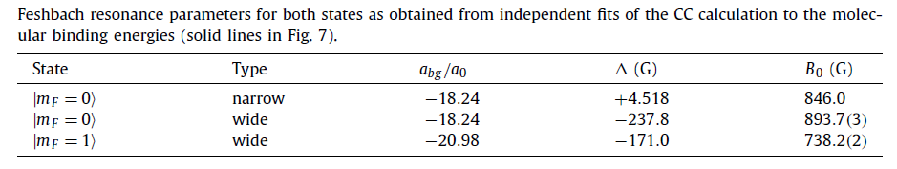
Mapping between the scattering length and the applied magnetic field
Precise characterization of Feshbach resonances by rf-spectroscopy of universal dimers.
Independent fit.
N. Gross, Z. Shotan, O. Machtey, S. Kokkelmans and L. Khaykovich, C.R. Physique 12, 4 (2011) ; arXiv:1009.0926

Slide 30
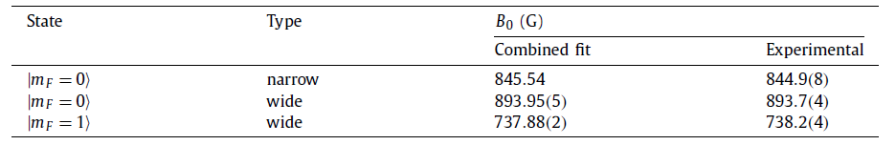
Mapping between the scattering length and the applied magnetic field
Precise characterization of Feshbach resonances by rf-spectroscopy of universal dimers.
Combined fit.
Improved characterization of Li inter-atomic potentials:
N. Gross, Z. Shotan, O. Machtey, S. Kokkelmans and L. Khaykovich, C.R. Physique 12, 4 (2011) ; arXiv:1009.0926

Slide 31
RF spectroscopy of the efimov quantum state

Slide 32
Rf association of Efimov trimers
Free-atoms to trimer transition? Can it work?
k
?

Slide 33
Rf association of Efimov trimers
Free-atoms to trimer transition?
k
Notes:
Close to the threshold point the trimer is a universal composite dimer which consist of a dimer and a (nearly free) atom. Atom-dimer scattering length diverges. We can try to associate these trimers (we know that dimers work perfectly well).

Slide 34
Energy levels

Slide 35
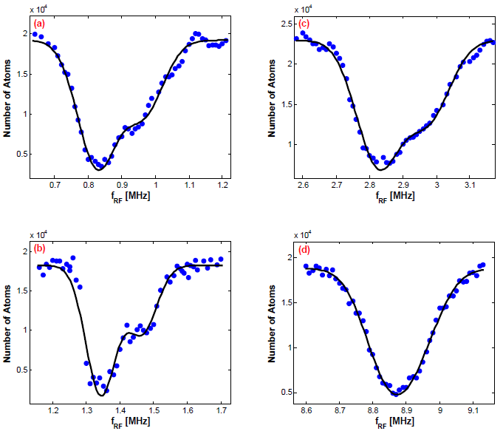
Rf scans
Remaining atoms after rf-pulse at different magnetic fields.
O. Machtey, Z. Shotan, N. Gross, and L. Khaykovich, PRL 108, 210406 (2012).

Slide 36
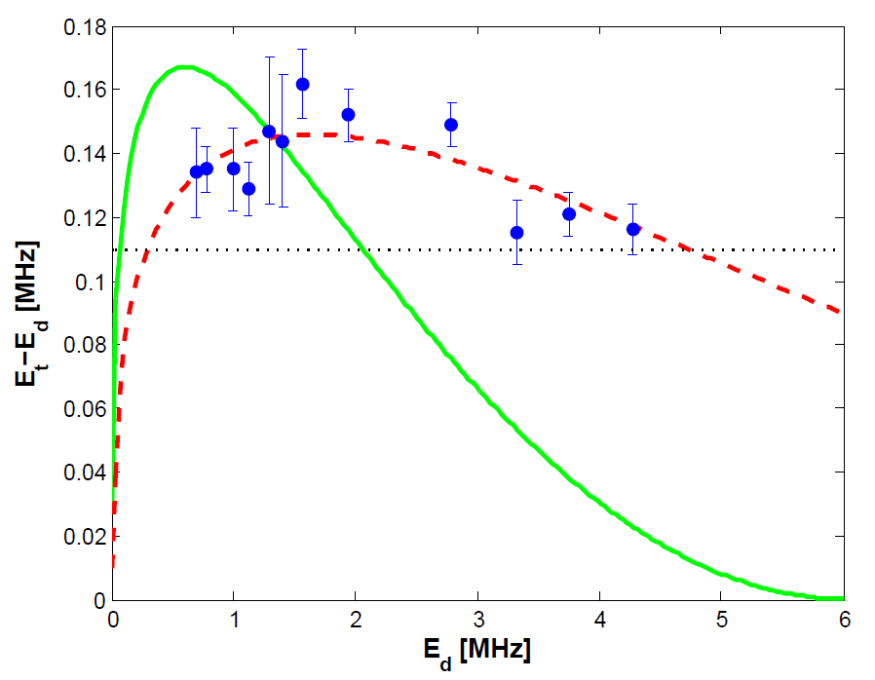
Trimer-dimer energy difference
Estimation:
O. Machtey, Z. Shotan, N. Gross, and L. Khaykovich, PRL 108, 210406 (2012).
Notes:
The universal theory is not completely wrong! It predicts correctly the depth of the Efimov trimer. However the tail is wrong.

Slide 37
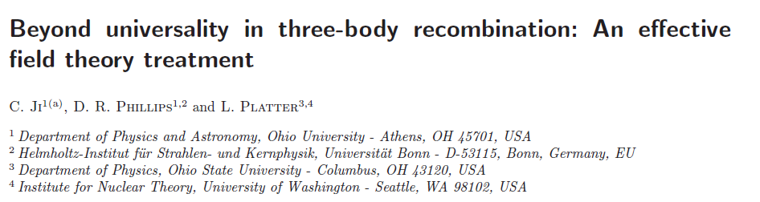
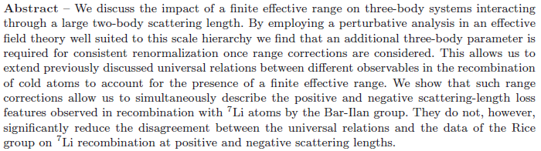

Beyond universality: NLO effective field theory
Prediction including finite effective range:
C. Ji, D. Phillips, L.Platter, Europhys. Lett. 92, 13003 (2010).

Slide 38
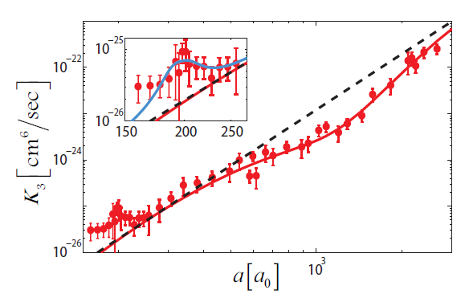
3-body recombination data
Secondary collisions resonance.
O. Machtey, Z. Shotan, N. Gross, and L. Khaykovich, PRL 108, 210406 (2012).
Notes:
3-body recombination can identify atom-dimer threshold through the avalanche resonance.

Slide 39
Efimov resonances at the atom-dimer threshold -
open answers to open questions

Slide 40
Efimov resonances
k
One atom and a dimer
couple to an Efimov trimer
Three atoms couple
to an Efimov trimer
Experimental observable - enhanced three-body recombination.
Notes:
I shall concentrate now on the positive side now.

Slide 41
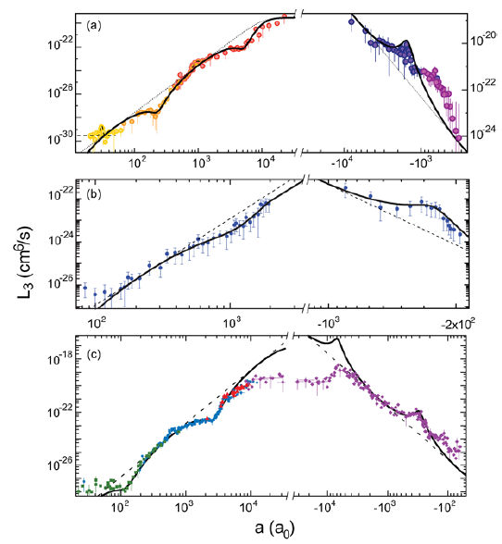
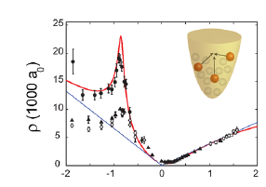
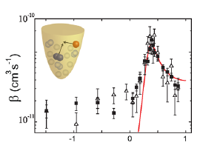
Gallery of the early experimental results
2009
Innsbruck -
¹³³Cs (2006; 2009)
Florence -
³⁹K
Bar Ilan -
⁷Li (m_{F}=0)
Rice-
⁷Li (m_{F}=1)
F. Ferlaino, and R. Grimm, Physics 3,9 (2010)
Notes:
All these results qualitatively established the Efimov effect. But no quantitative understanding. Let us concentrate only on the negative scattering length side for sometime.

Slide 42
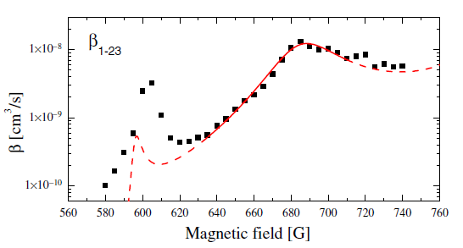
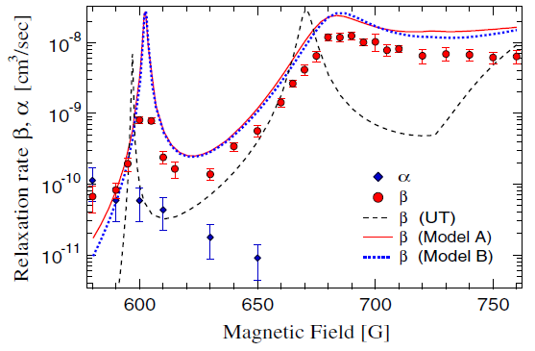
Gallery of the experimental results - ⁶Li
T. Lompe, T. B. Ottenstein, F. Serwane, K. Viering,
A. N. Wenz, G. Zurn and S. Jochim,
PRL 105, 103201 (2010).
S. Nakajima, M. Horikoshi, T. Mukaiyama,
P. Naidon and M. Ueda, PRL 105, 023201 (2010).

Slide 43
Three-body recombination data - ⁷Li
O. Machtey, Z. Shotan, N. Gross, and L. Khaykovich, PRL 108, 210406 (2012).

Slide 44
Efimov resonances at the atom-dimer threshold -“quantitative disorder”
Efimov resonance at the atom-dimer threshold:
Reminder: Efimov resonance at the three-atom continuum:

Slide 45
Reevaluation of experimental observables

Slide 46
3-body recombination again
At the Efimov resonances elastic and inelastic atom-dimer cross-sections are enhanced.
Initially - free atoms. Secondary collisions.
³⁹K and ⁷Li
Initially – atom-dimer mixture.
¹³³Cs and ⁶Li
Monitoring the loss of dimers.
Monitoring the loss of atoms.
Notes:
Two experimental strategies

Slide 47


Atom-dimer cross-sections
Braaten & Hammer, Phys. Rep. 428, 259 (2006)
Notes:
Both cross-sections are maximized at a_star but their a-dependent behavior is different.

Slide 48
Mean number of atom-dimer collisions
Two possible scenarios that a dimer can undergo on its way out of the trap:
  The dimer collides elastically with k atoms and leaves the trap.
  After k elastic collisions, the dimer undergoes one inelastic collision which ends up the secondary collisions sequence.
Within the assumption of energy independent elastic and inelastic cross sections,
the answer is analytically tractable:
O. Machtey, D. A. Kessler, and L. Khaykovich, PRL 108, 130403 (2012).
See also a similar model in M. Zaccanti et.al., Nature Phys. 5, 586 (2009).

Slide 49
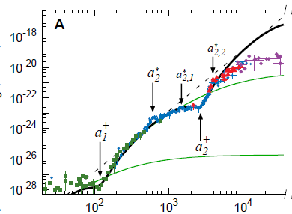

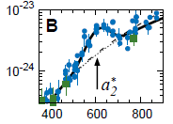
Two ⁷Li experiments:
BEC (Rice).
Thermal gas (Bar Ilan).
S. E. Pollock, D. Dries, and R. G. Hulett
Science 326, 1683 (2009).
O. Machtey, Z. Shotan, N. Gross, and L. Khaykovich,
PRL 108, 210406 (2012).

Slide 50
Two ⁷Li experiments:
BEC (Rice).
Thermal gas (Bar Ilan).
Large collisional opacity.
Small collisional opacity.
is maximized when
O. Machtey, D. A. Kessler, and L. Khaykovich, PRL 108, 130403 (2012).

Slide 51
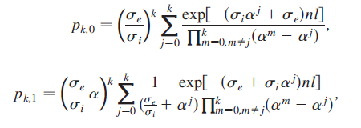
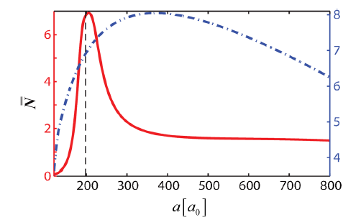
Two ⁷Li experiments:
Energy dependent inelastic cross sections gives:
mean energy reduction per collision
O. Machtey, D. A. Kessler, and L. Khaykovich, PRL 108, 130403 (2012).

Slide 52
Efimov resonances at the atom-dimer threshold -“quantitative disorder”?
Finite range corrections scales with r₀ and (probably) with R*

Slide 53
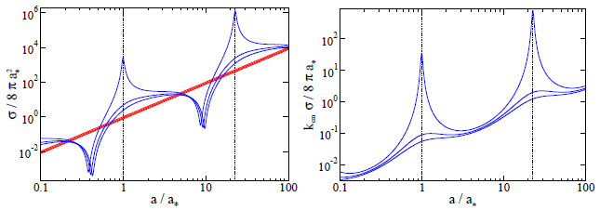
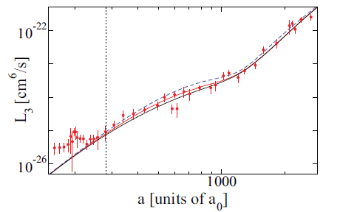
Open answer to open question
NO NARROW RESONANCES
Fit with Monte-Carlo simulations,
taking into account energy dependence
of the elastic cross-section, finite depth
of the potential etc…
C. Langmack, D. H. Smith, and E. Braaten, PRA 86, 022718 (2012) & arXiv:1209.4912

Slide 54
Conclusions and outlook
We observed a number Efimov features by a number of experimental techniques and determined the three-body parameter.
Are all the observed features real? Do we see the atom-dimer resonance?
Possible explanations of disagreement with the Monte-Carlo simulations:
  p-wave collisions serves as a buffer to slow down fast molecules.
  inclusion finite range corrections (initial energy of the dimer is overestimated and the cross-section is, probably, underestimated).
Quest for a theory which could trace will include the finite range corrections with the real ⁷Li potential.
Lifetime of trimers: “quantitative chaos”.

Slide 55
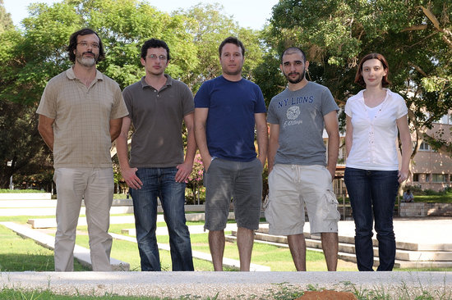
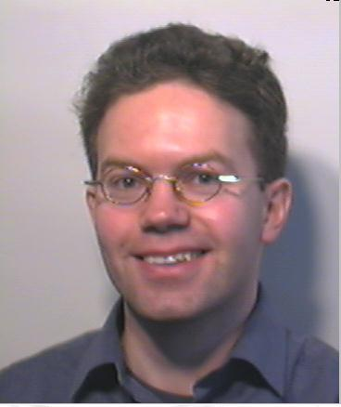
People
Bar-Ilan University, Israel
Eindhoven University of
Technology, The Netherlands
Servaas Kokkelmans
David A. Kessler (not in the picture)

