Slide 1
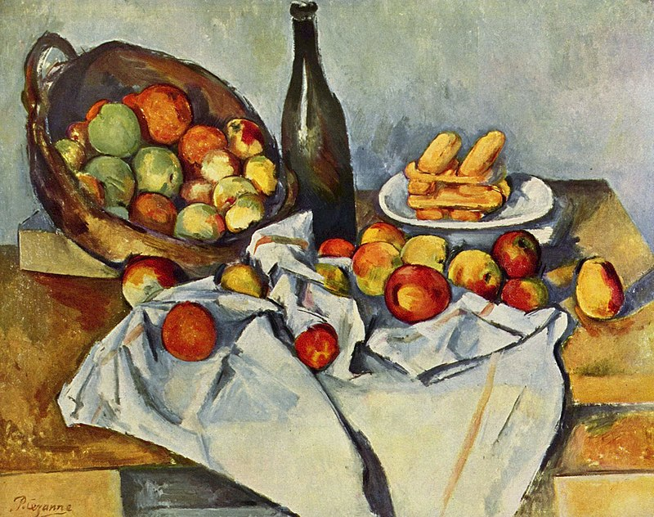
Generalized Hydrodynamics of Creation and Decay
Olalla Castro-Alvaredo
Department of Mathematics
City, University of London
PARIS 24/09/2021

Slide 2
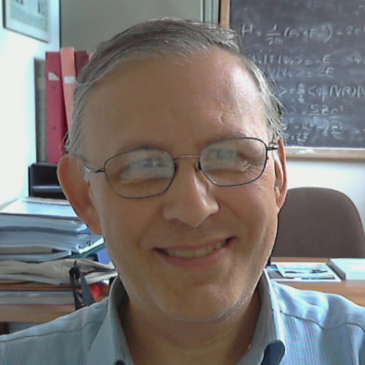
1. Papers
The work I will present today contains results of two papers:
OC-A, Cecilia De Fazio, Benjamin Doyon and Francesco Ravanini
On the Hydrodynamics of Unstable Excitations
JHEP 09 (2020) 045; arXiv:2005.11266
OC-A, Cecilia De Fazio, Benjamin Doyon and Aleksandra A. Ziółkowska
Tails of Instability and Decay: a Hydrodynamic Perspective; arXiv:2103.03735
OC-A, Cecilia De Fazio, Benjamin Doyon and Aleksandra A. Ziółkowska
Generalized Hydrodynamics of Particle Creation and Decay
To Appear Soon!
Thanks!

Slide 3
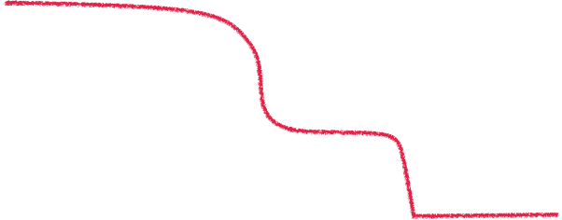
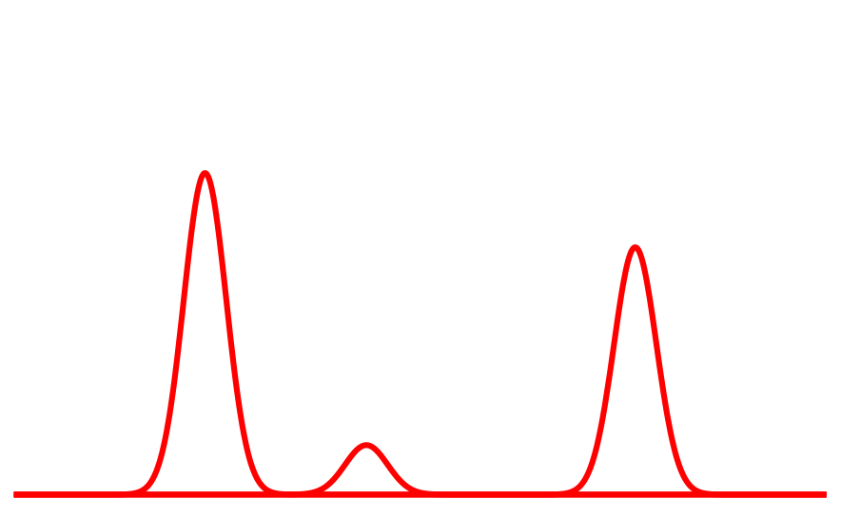
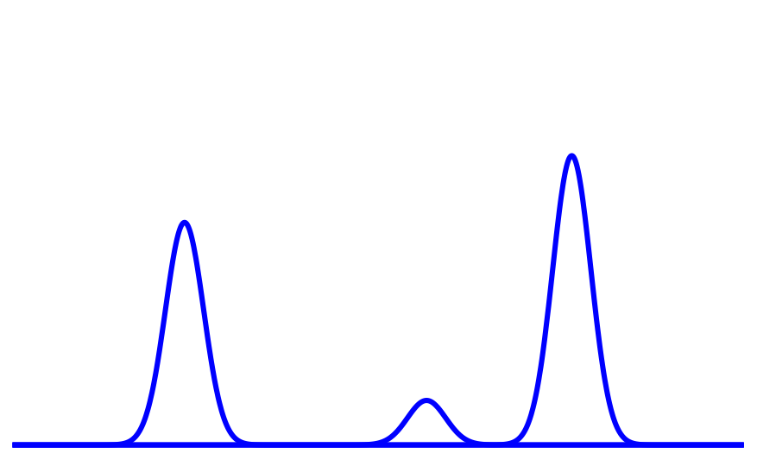
2. Structure
$$c(β)$$
$$c=6/5$$
This talk is organized as follows:
$$c=1$$
The $SU(3)_{2}$-Homogeneous sine-Gordon Model
$$−σ/2$$
$$logβ/2$$
[OC-A, Fring, Korff & Miramontes’01]
Generalized Hydrodynamics
$$ρ_{p}^{+}$$
Results
$$ρ_{p}^{−}$$
$$θ^{⋆}$$
$$θ^{⋆}+σ$$

Slide 4
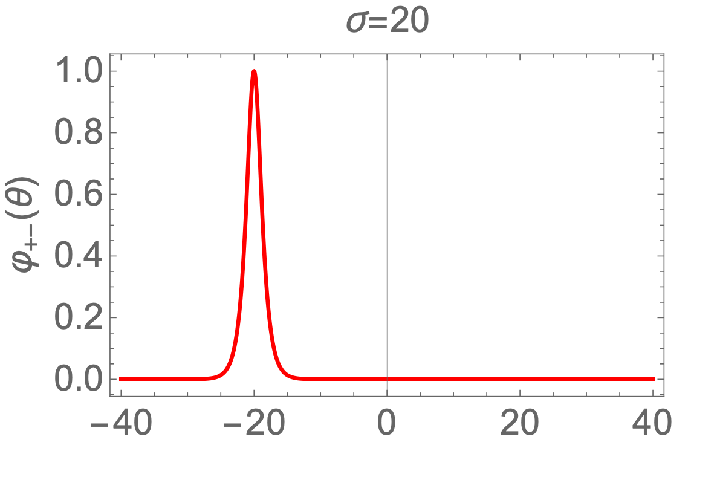
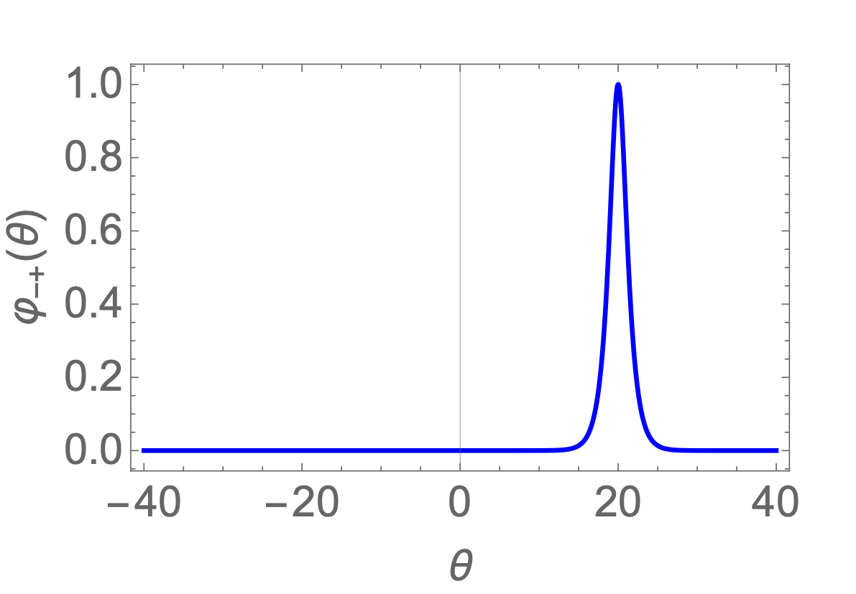
3. Our Model: $SU(3)_{2}−HSG$
$$G=A_{2}A_{k−1}=A_{1}=Ising$$
Our model is the simplest non-trivial theory in the series. We have two (stable, asymptotic) particles which form one unstable particle.
+
$$σ$$
-
$$S_{±±}(θ)=−1,S_{±∓}(θ)=±tanh\frac{1}{2}\left(θ±σ−\frac{iπ}{2}\right)$$
[Miramontes & Fernández-Pousa'00]
For $σ→∞$ we have two free fermions
For $σ≫1$ the mass of the unstable particle is $∝me^{|σ|/2}$
$$−i\frac{d}{dθ}log(S(θ))$$
$$φ_{±±}(θ)=0,φ_{±∓}(θ)=sech(θ±σ)$$

Slide 5
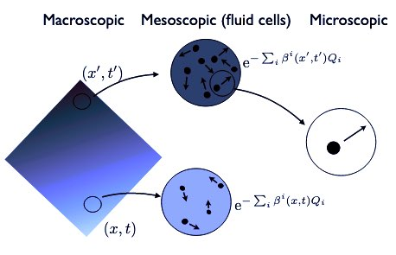
4. Generalized Hydrodynamics (GHD)
GHD is a technique that allows us to describe the large time out-of-equilibrium dynamics of many-body quantum systems. The concept of fluid cells plays a prominent role.
In conventional hydrodynamics this means that local averages on a fluid cell are described by a Gibbs ensemble $Z=e^{−βH}$
$$⇒e^{∑_{i}β_{i}Q_{i}}GGE$$
The input here are conservation laws and the principle of emergent hydrodynamics (local entropy maximization).
[Doyon’19]
In integrable models, this is generalized to GGEs, leading to the GHD principle first proposed in [O.C-A, Doyon & Yoshimura'16; Bertini, Collura, De Nardis & Fagotti’16]. For a pedagogical review see [Doyon, Lecture notes on Generalised Hydrodynamics'19]

Slide 7
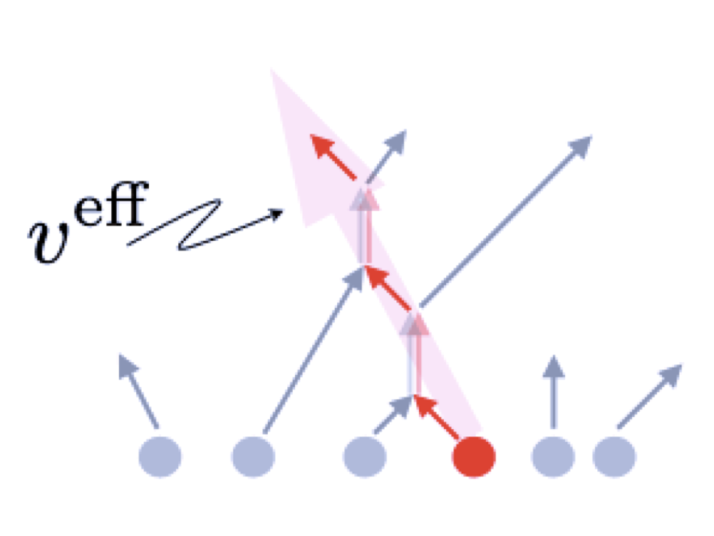
6. Averages
The occupation numbers characterised the state. Then, GHD provides a method to compute correlation functions of local operators. The average current and average density associated to a conserved quantity $q_{i}$ with eigenvalue $h_{i}(θ)$ are given by:
$$j_{i}=\frac{1}{2π}∫_{−∞}^{∞}dθp(θ)h_{i}^{dr}(x,t,θ)n(x,t,θ),q_{i}=\frac{1}{2π}∫_{−∞}^{∞}dθe(θ)h_{i}^{dr}(x,t,θ)n(x,t,θ)$$
The effective velocity is the velocity of propagation due to interaction. $v^{eff}(θ)=tanhθ$ for free theories
In this talk I will focus on just a few functions:

Slide 8
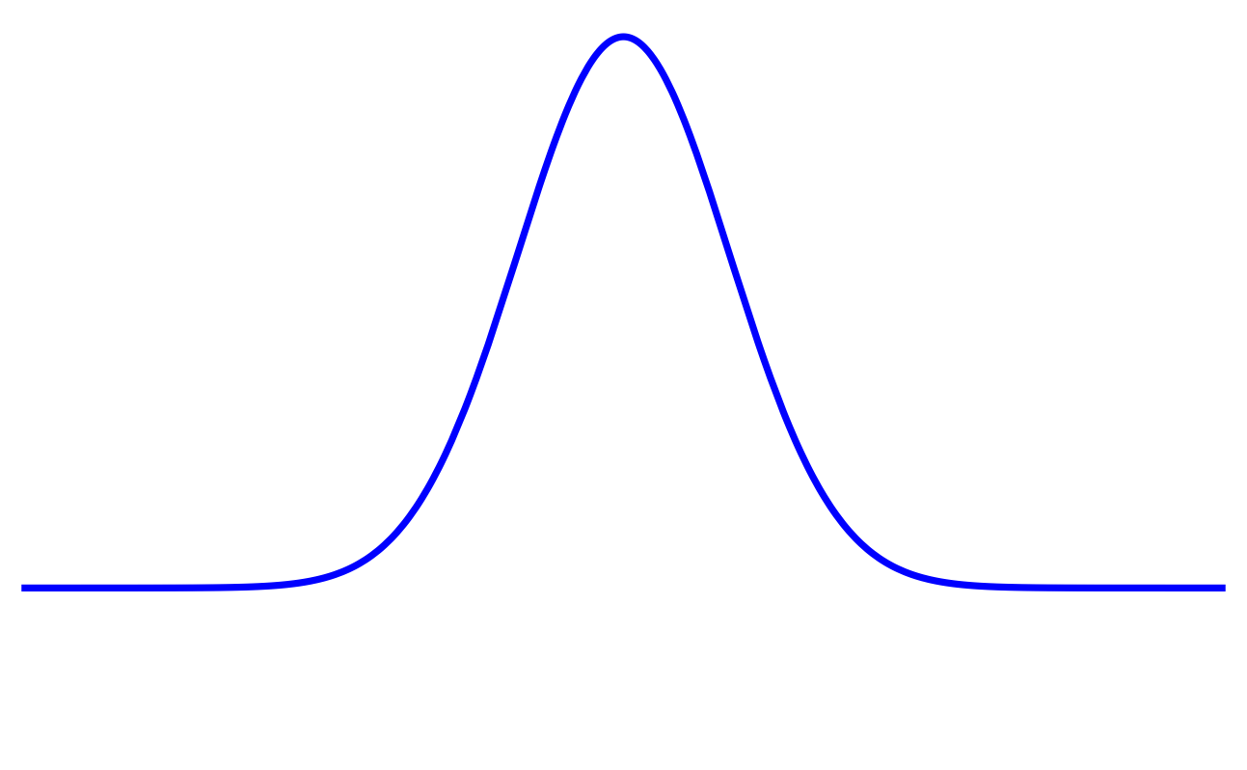
7. Out-of-Equilibrium
In our recent paper we considered an out-of-equilibrium situation where the initial state is characterised by a gaussian temperature profile in space.
$$T_{m}$$
We found that this is an ideal set-up in which to find signatures not only of the formation of unstable particles but also of their decay under time evolution.
$$T(x)=T_{a}+(T_{m}−T_{a})e^{−x^{2}}$$
$$T_{a}$$
It turns out that the presence ($T_{a}≠0$) or absence ($T_{a}=0$) of a bath reveals different phenomena.
$$x$$
The solution by the method of characteristics of the GHD equations in this situation was presented in [Doyon, Spohn & Yoshimura’18]. In our work we used the numerical solution of GHD as implemented in [Møller & Schmiedmayer’20] known as iFluid.

Slide 9
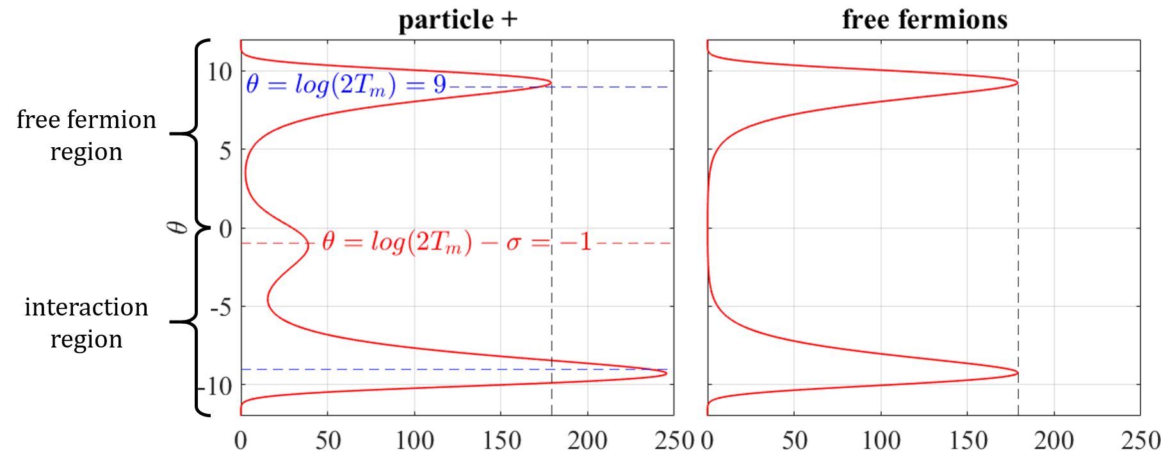
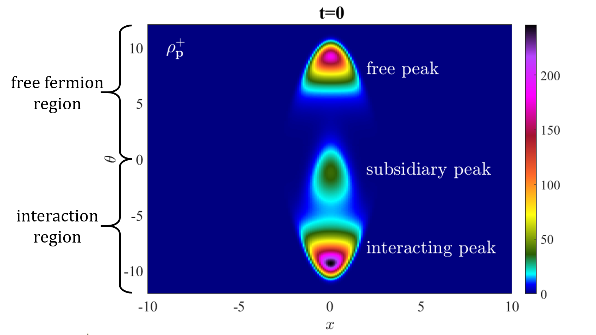
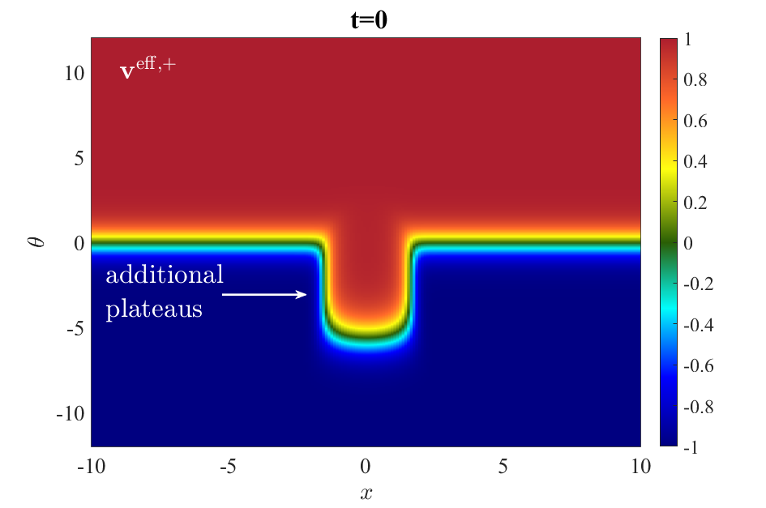
8. (Local) Equilibrium

Slide 10
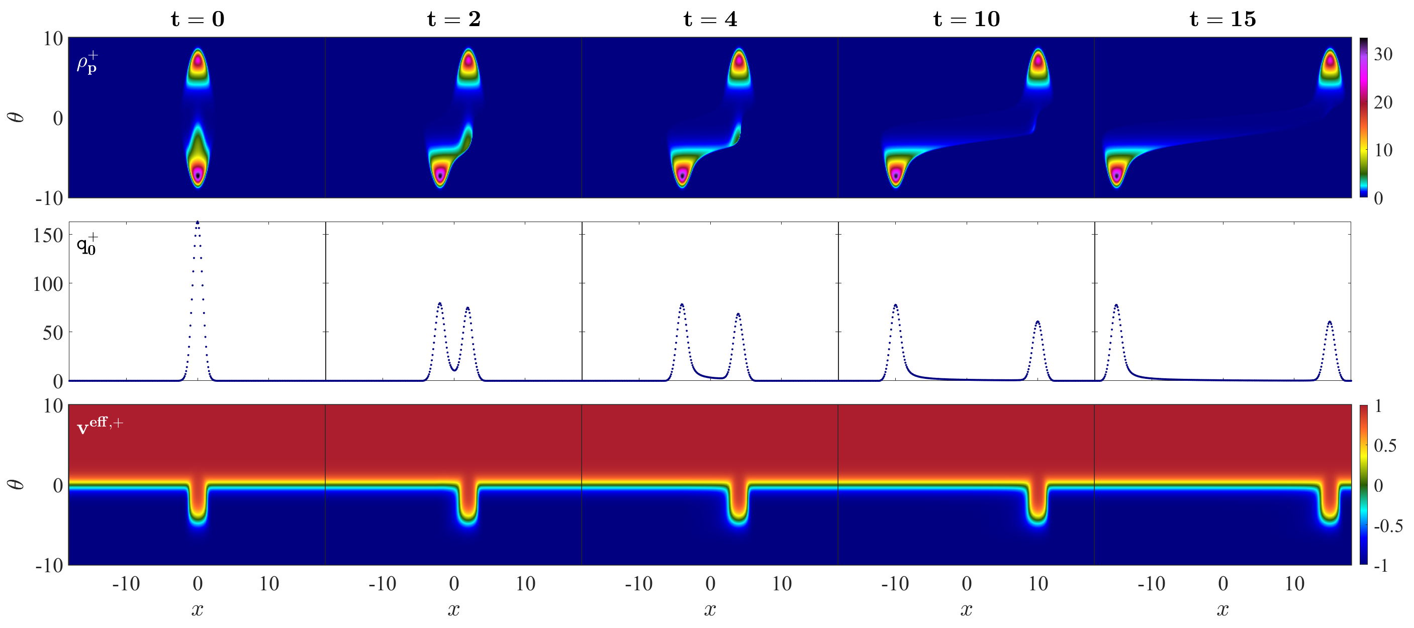
9. Dynamics in the Absence of a Bath
Here $T_{m}$ is such that unstable particles are present in the initial state.
We see the decay of the S peak of the spectral density and the formation of a tail. We can associate this tail with the decay of unstable particles.
Here, $σ=10,log(2T_{m})=7$ and we are looking at the spectral density, particle density and effective velocity of particle +. Those of particle - are related, for instance $v^{eff,+}(x,t,θ)=−v^{eff,−}(−x,t,−θ)$

Slide 11
10. Dynamics in the Presence of a Cold Bath
Here, $σ=10$, $log(2T_{m})=7$, $log(2T_{a})=3$ and and we are looking at the spectral densities of particles + and - for $θ>0$
$T_{m}$ is such that unstable particles are present in the initial state and $T_{a}$ is a temperature which, at equilibrium, would correspond to the free fermion regime.
We still see a bit of a tail in $ρ_{p}^{−}(x,t,θ>0)$ but the main feature is that there is now a persisting peak of the spectral density $ρ_{p}^{+}(x,t,θ>0)$ that is “riding” on top of the bath ridges and apparently moving at speed +1. Why?

Slide 12
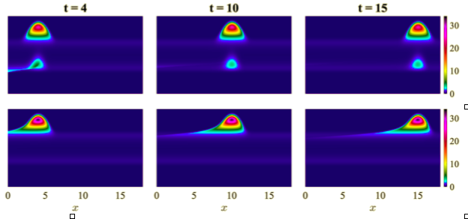
11. Magnetic Fluid Effect
The bath interacts with the
“magnet”, is being pulled
along by it, allowing for
a persistent density
of particles to travel with it
Magnet-like interacting peak moving at speed +1

Slide 13
12. No Bath vs Bath Dynamics

Slide 14
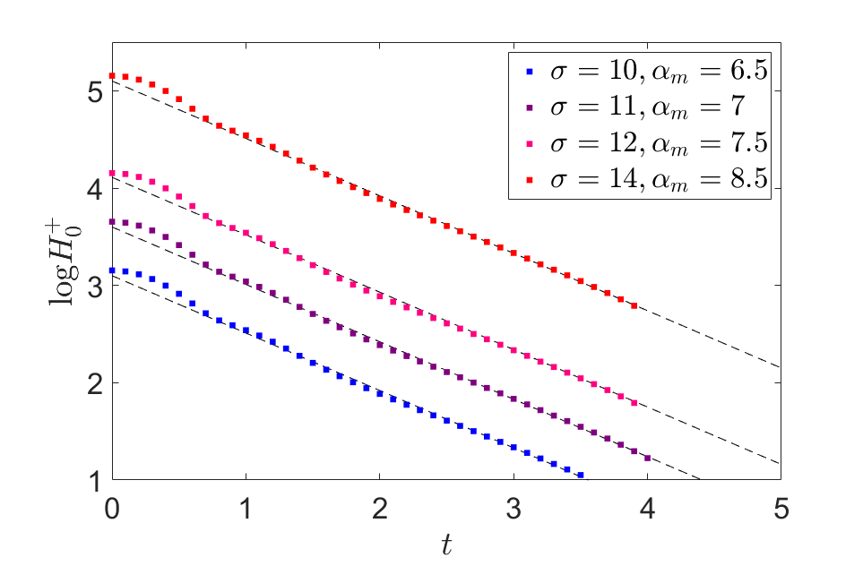
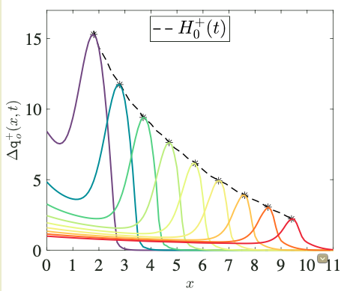
13. Quantifying Decay
$$α_{m}=log(2T_{m})$$
$$H_{0}^{+}(t)≈Ae^{−tf(κ)}withκ=log(2T_{m})−\frac{σ}{2}$$

Slide 15
14. Conclusions
GHD can offer new insights into scattering, decay and formation of particles.
These new insights are particularly interesting for a model where parity is broken and where unstable particles affect the dynamics.
In our work we have identified signatures of the formation and decay of such particles (i.e. tails and additional maxima of the spectral density). We think at least some of these signatures are universal markers of the formation and decay of particles.
The decay rate of the subsidiary peak is a function of the universal ratio ${T_{m}}/{e^{σ/2}}$, that is the ratio of the overall energy scale against the mass of the unstable particle. As expected, decay is slower, the higher the energy scale (the closer to the UV).

