Slide 1

Fête Hubert
Goal of my talk: to tell Hubert
something he doesn’t already know

Slide 2
Free fermions and parafermions
Paul Fendley
All Souls College, University of Oxford

Slide 3
Free fermions
The fundamental system in theoretical physics
Many properties can be computed exactly
Keeps on keeping on
e.g. topological classification, entanglement, quenches…
Appear in many non-obvious guises. Moreover, often occurs as a special point in space of couplings (typically not that many relevant couplings).
Despite all this, still possibly underused in stat-mech/field theory.

Slide 4
What is a free fermion?
Forget statistics, forget operators, forget fields…
In a free-fermion quantum system, the entire spectrum is of the form
The choice of each is independent, and does not affect the values of .
Excited levels
Levels are either filled or empty:
Fermi sea

Slide 5
The usual (lattice) story
Automatically find such a spectrum when Hamiltonian is a bilinear in fermions:
where is an antisymmetric matrix, and the (Majorana) fermions obey
Examples of non-obvious free-fermionic systems:
1d quantum transverse-field/2d classical Ising
Kauffman, Onsager; its fermionic version now known as the ``Kitaev chain’’
1d quantum XY
Jordan-Wigner; Lieb-Schultz-Mattis
2d Kitaev honeycomb model
sine-Gordon at special point
Coleman; Luther-Emery

Slide 6
Canonical example: the Ising/Kitaev chain
transverse field favouring disorder
interaction favouring order
The are Pauli matrices acting on site j of the L-site chain.
The non-local Jordan-Wigner transformation maps it to
Notes:
H=-i h\sum_{j=1}^L \psi_{2j-1}\psi_{2j} -iJ\sum_{j=1}^{L-1} \psi_{2j}\psi_{2j+1}

Slide 7
Really easy to find spectra of such Hamiltonians
Commuting a linear in fermions with a bilinear gives a linear back:
where
eigenvectors:
The raising and lowering operators are then
The eigenvalues are the zeroes of a polynomial whose coefficients depend
on the couplings. Thus instead of diagonalizing a matrix, now
a one.
Notes:
{\cal H}= i \begin{pmatrix} 0&h&0&0&0&\cdots\cr
-h&0&J&0&0&\cdots\cr
0&-J&0&h&0&\cdots\cr
0&0&-h&0&J&\cdots\cr
&&&\vdots
\end{pmatrix}\Bigg[ H,\, \sum_{a=1}^{2L} r_a \psi_a\Bigg] = \sum_{b=1}^{2L} s_b \psi_b

Slide 8
One more step: To find free-fermion spectrum, need to show that raising/lowering operators have algebra
in addition to

Slide 9
By now many many models have been solved by J-W transformations. Do one on your fave chain, and if the Hamiltonian is quadratic in fermions, you win!
Recently, a general result for when J-W transformation to free fermions is possible. Describe terms in lattice Hamiltonian by a ``frustration” graph, and for it to be quadratic in fermions, graph must have certain properties.
Chapman-Flammia, 2003.05465
Is that all there is?
Notes:
E=\pm\epsilon_1 \pm \epsilon_2\pm\;\cdots \,\pm \epsilon_{L}

Slide 10
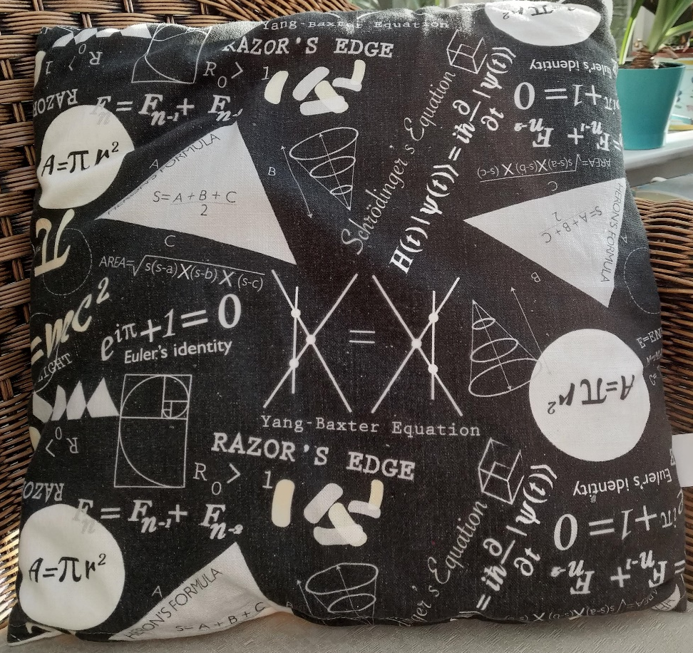
I’ll describe how to construct raising and lowering operators in some more general models using elementary algebra.
Strangely, technique only works for open boundary conditions, model remains integrable for periodic but not free. But first, the models….

Slide 11
Rewriting the models in a more algebraic form
Generalise Ising/Kitaev Hamiltonian to allow spatial dependence
constants
These operators obey a very simple algebra
…
Incidence graph:
Using this algebra, construct operators that obey
Spectrum then follows independent of representation.
Notes:
h_{m}^2 = t_m^2\, ,\quad
h_m h_{m+1} = - h_{m+1}h_m\, ,\quad
h_m h_{m+2} = - h_{m+2}h_m\, ,\cr
%h_m h_{m'} = h_{m'}h_m\quad {\rm for }\ |m-m'|>2

Slide 12
Free fermions in disguise
Fendley 2019
constants
The generators anticommute two sites apart as well:
…
The J-W transformation gives a purely four-fermi Hamiltonian:
This model has an N=2 supersymmetry, with generators made of fermion trilinears.
Notes:
H_{4-fermi}&=\sum_{a=1}^{2L} \psi_{a-1}\psi_{a}\psi_{a+2}\psi_{a+3}\cr
&=-\sum_{j=1}^L
\left(\sigma^z_{j}\sigma^z_{j+1}\sigma^x_{j+2} + \sigma^x_j\sigma^z_{j+1}\sigma^z_{j+2}\right)

Slide 13
Baxter’s Hamiltonian
Analogs of Pauli matrices for an n-state spin are
``shift’’
``clock’’
Like with Ising, set
Not Hermitian! No + h.c.
Note!
Algebra:

Slide 14
The KBBS Hamiltonian
Korepanov 87; Baxter 89; Bazhanov and Stroganov 89
Baxter 2004; Baxter 2013; Au-Yang+Perk 2014
aka model, aka BS model
The same shift-clock algebra as before:
but Hamiltonian is long-ranged:
constants
In terms of parafermions, each term is bilinear

Slide 15
How to show these models are ``free’’:
Find a transfer matrix T(u) obeying [H, T(u)]=0 for all u.
In these examples, easy to do using the algebra of the
Show that
Usually use Yang-Baxter, but here straightforward to do directly
Find ``inverse’’ such that
Raising and lowering (more generally shift) operators are constructed for each zero obeying
They obey
polynomial
where the ‘’simplicial’’ mode χ is an extra Hamiltonian generator at an edge.
Rather miraculous.

Slide 16
The transfer matrix
Ising: where adjacent anticommute, others commute.
Non-local conserved charges involve at least 2 sites apart:
obeys ``inversion’’ relation
polynomial
Local conserved charges follow from logarithmic derivative of T(u).
Notes:
J^{(3)}= \sum_{m_1+1<m_2<m_3-1} h_{m_1}\,h_{m_2}\,h_{m_3}

Slide 17
And for the four-fermi model
Also include in algebra
Non-local conserved charges involve at least 3 sites apart:
obeys ``inversion’’ relation
Notes:
J^{(3)}= \sum_{m_1+1<m_2<m_3-1} h_{m_1}\,h_{m_2}\,h_{m_3}

Slide 18
Same form for parafermion case!
even though here
Non-local conserved charges involve at least 2 sites apart:
obeys ``inversion’’ relation
polynomial
The KBBS model works out similarly.
Notes:
J^{(3)}= \sum_{m_1+1<m_2<m_3-1} h_{m_1}\,h_{m_2}\,h_{m_3}

Slide 19
The raising/lowering operators
follow from one magical identity.
Include an edge fermion/parafermion χ obeying and
e.g. for Ising
In all these models, the transfer matrices and Hamiltonian obey
Since
and
it follows immediately that
obeys
Notes:
T(u)\Big(\psi+ \omega u \big[ H,\, \psi\big]\Big) = \Big(\psi+ u\big[ H,\, \psi\big]\Big) T(u)

Slide 20
Free fermions in disguise
One more step: need to show raising/lowering operators in both Ising and 4-fermi models obey the same algebra
Only distinction:
for Ising
for 4-fermi
Thus exponentially large degeneracies for each energy in 4-fermi model!

Slide 21
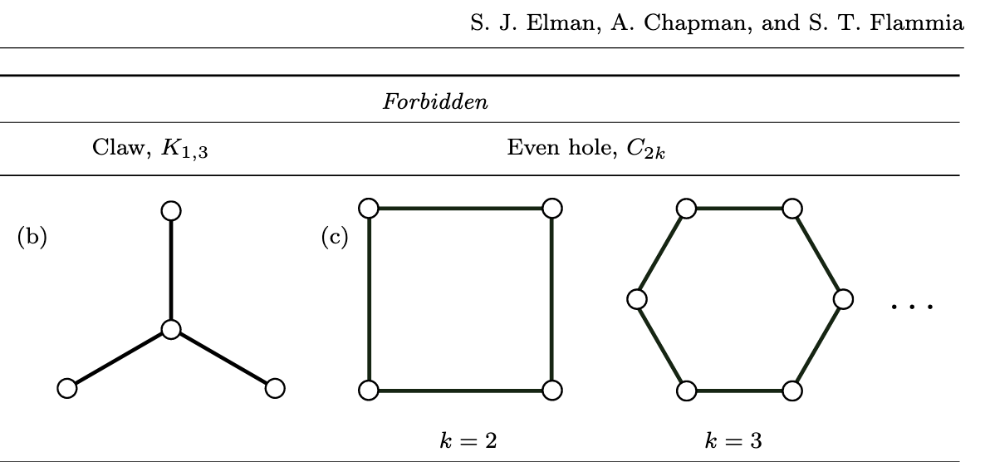
Connection to graph theory
Remarkably, can find a general set of criteria that explains when free fermions are in disguise.
Elman, Chapman and Flammia
Works when the frustration graph is even-hole-free, claw-free.
…

Slide 22
Get free parafermions as well!
Anticommutation relations generalise to
Baxter’s chains have spectrum
where
Baxter 1989
and each
Baxter 1989
2014
Fendley 2013
2021
Au-Yang/Perk
2014, 2016
Notes:
E=\omega^{m_1}\epsilon_1\; +\; \omega^{m_2}\epsilon_2\; +\;\cdots \,+\,\omega^{m_L}\epsilon_{L}
(u_l - \omega u_k) \Psi_k \Psi_{l} = (u_k - \omega u_l) \Psi_{l} \Psi_k

Slide 23
The physics of the four-fermi chain
The free-fermion raising/lowering operators are non-linear and non-local in the original fermions. Thus e.g. no Wick’s theorem in real space.
Nevertheless, the spectrum is free-fermionic:
where the are the roots of an order S=2L/3 polynomial.
One unusual property: each energy is exponentially degenerate. Degeneracies arise from extended supersymmetry algebra.
Notes:
=\sum_j \big(t_{2j}\sigma_j^z\sigma_{j+1}^z \sigma^x_{j+2} + t_{2j+1} \sigma_j^x\sigma_{j+1}^z \sigma^z_{j+2}\big)

Slide 24
Find that at the self-dual point/uniform couplings, theory is critical, but not a CFT. Instead, it has dynamical critical exponent z=3/2.
Staggering on every third site
gives phase diagram
Imposing periodic b.c. breaks degeneracies and gives rise to a distinct z. Even though it’s integrable, not free-fermion, and too difficult (for me at any rate) to extract answer analytically.
Hello numerical experts? Bethe-ansatz fiends?

Slide 25
Combining Ising and four-fermi chains
Combination is not only not free-fermion, it’s not even integrable.
Find a non-trivial critical point with only one-parameter tuning and without changing the Hilbert space. Thus ideally suited for testing numerical methods.
Along self-dual line, interesting properties such as supersymmetry and order-disorder coexistence.
O’Brien and Fendley

Slide 26
Order and disorder coexist along the first-order transition line
Order-disorder coexistence
Although the three ground states are exact only at , the phase persists along the self-dual line up to the pure 4-fermi point.
Exact ground states
Tricritical Ising point
Ising critical line

Slide 27
Lots more to do
Exact edge zero modes?
Field theory?
(Superintegrable) chiral Potts transfer matrix is inverse of KBBS one. Lots of mysteries…
Connection to experiment both in Ising+4-fermion and in chiral Potts
Close connection to integrable Bazhanov-Baxter models in 3d
Connection to chiral CFTs?
Aasen et al 2020
Rydberg blockade

Slide 28
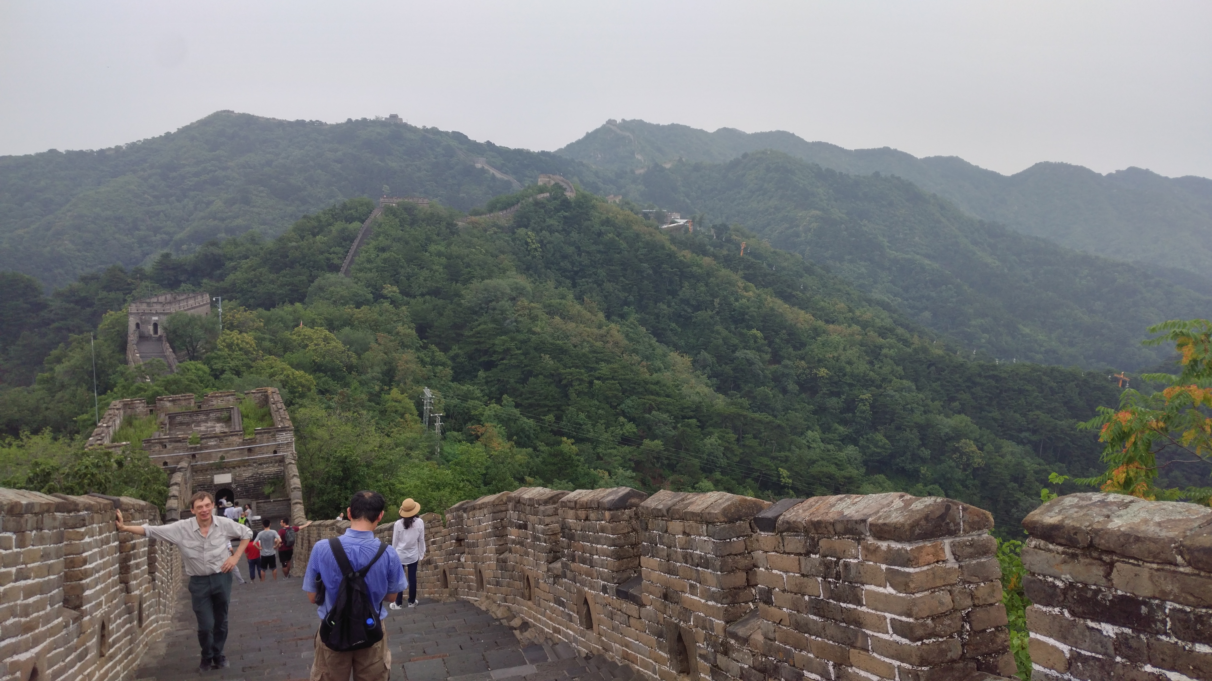
Many Happy Returns!

