Slide 1
Generalised Riemann Hypothesis
and Brownian Motion
Giuseppe Mussardo
SISSA-Trieste

Slide 2

“Scientist is the one who knows how to get a solution out of an enigma”
Hubert Saleur

Slide 3
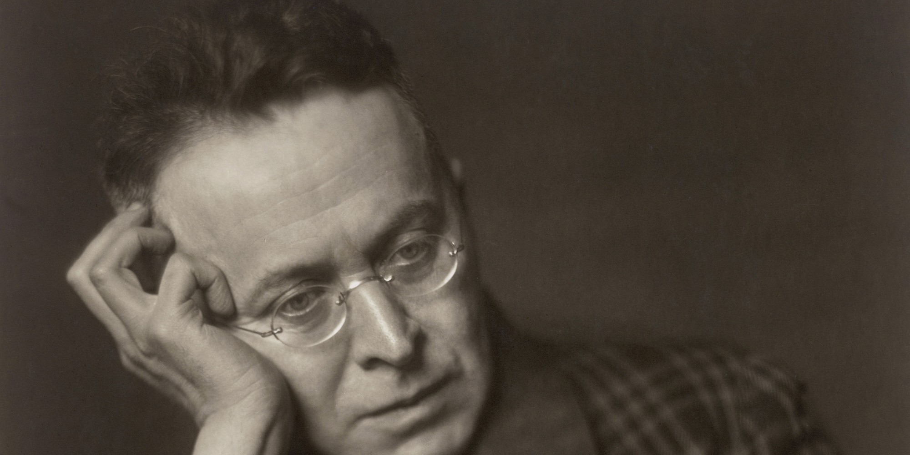
“Scientist is the one who knows how to get a solution out of an enigma”
Karl Kraus

Slide 4

S

Slide 5
S
Notes:
Adolf Piltz in 1884

Slide 6
S

Slide 7
S

Slide 8
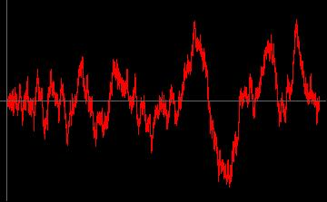
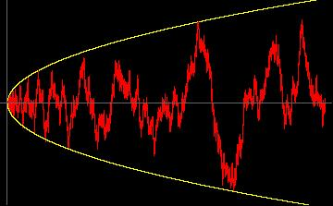
S

Slide 9
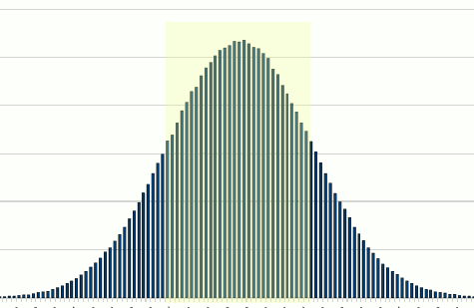
S

Slide 10
S

Slide 11
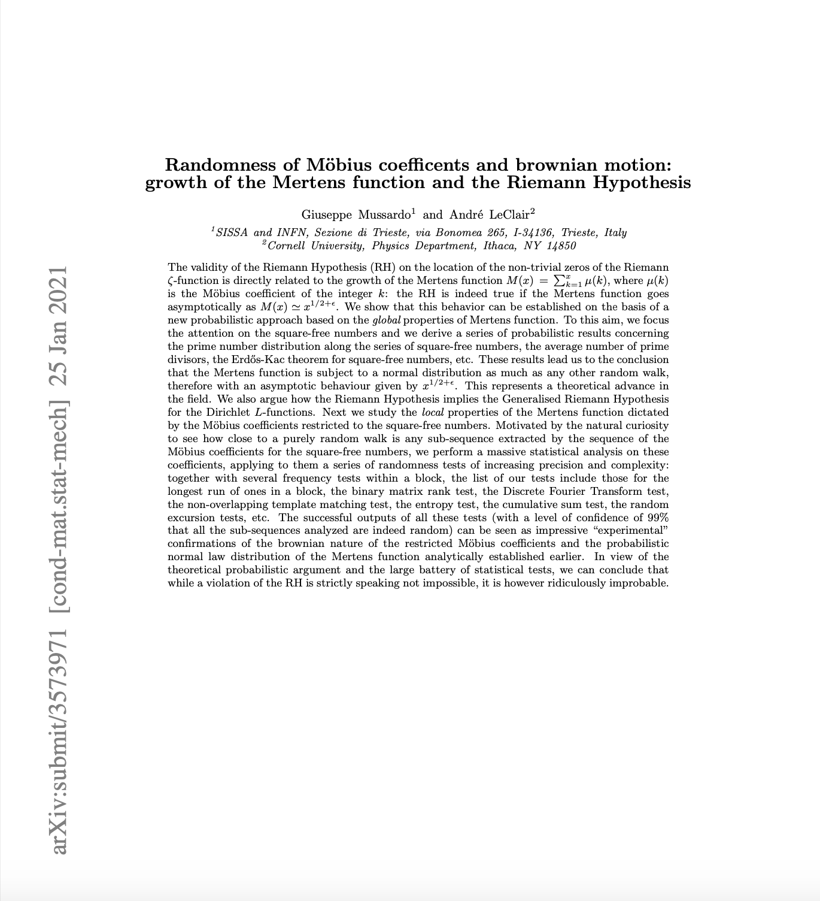
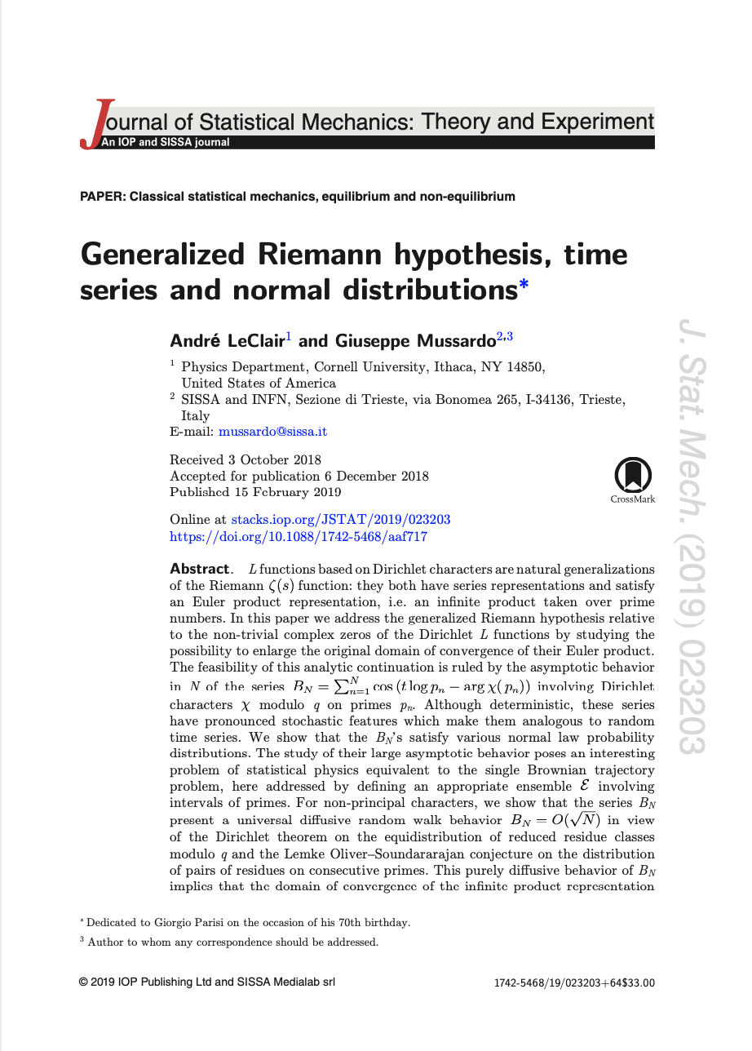
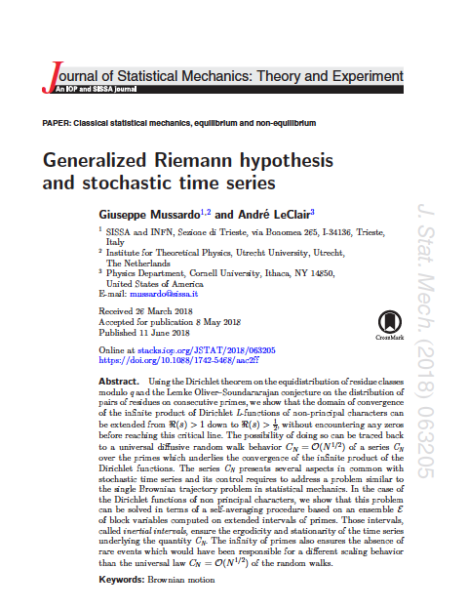

Slide 12
Topics of the seminar
Randomness vs Determinism
Riemann’s Hypothesis
Dirichlet characters, L - functions and all that
The Generalised Riemann Hypothesis
For Whom the Bell Tolls

Slide 13

Randomness vs Determinism

Slide 14
Number Theory is usually considered as a field rigidily
ruled by the “military” deterministic laws of arithmetic,
where randomness seems to play no role.

Slide 15
Is it really so??

Slide 16
I would like to undermine this certainty of yours

Slide 17
A significant example
Arithmetic tales from the world of 𝜋

Slide 18
Law and (dis)order in 𝜋

Slide 19
Law and (dis)order in 𝜋

Slide 20
Law and (dis)order in 𝜋
F_{k} is the k-th Fibonacci number

Slide 21
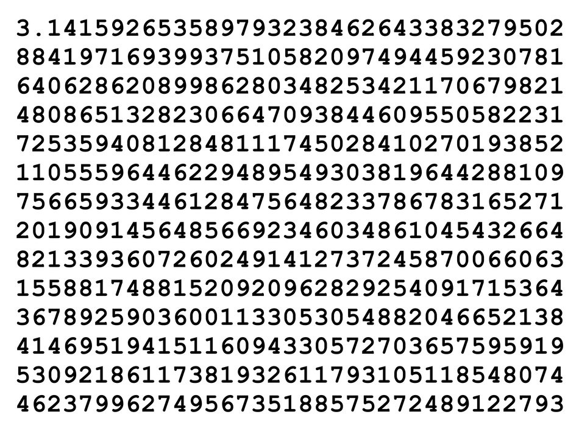
Order and disorder in 𝜋

Slide 22
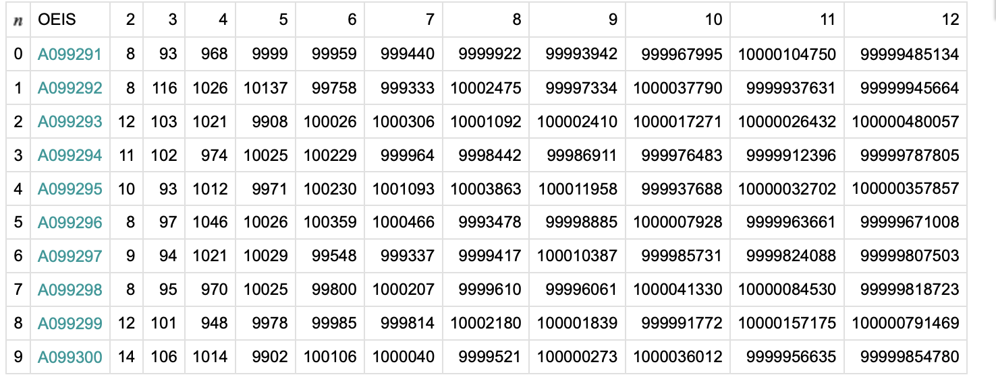
Law and (dis)order in 𝜋
10^{d}
d
n

Slide 23
Law and (dis)order in 𝜋
First 5.000.000 digits

Slide 24
Order and disorder in 𝜋

Slide 25
Law and (dis)order in 𝜋
First 60.000.000 digits

Slide 26
Order and disorder in 𝜋

Slide 27
Law and (dis)order in 𝜋
First 60.000.000 digits

Slide 28
Displacement function of the digits of 𝜋

Slide 29
Displacement function of the digits of 𝜋
How is the S(n) distributed?
20.000 digits

Slide 30
Dr. Riemann and his function

Slide 31
The Riemann zeta Function
Free bosonic system

Slide 32
The Riemann zeta Function
Grand canonical
Ensemble
Micro canonical
Ensemble

Slide 33
The Riemann zeta Function
Functional equation

Slide 34
The Riemann zeta Function
S
conjectured
(non-trivial zeros)
certain
(trivial zeros)

Slide 35
The Riemann zeta Function
Duality
S

Slide 36
Number of zeros in the critical strip
(Riemann, von Mangoldt)

Slide 37
Number of zeros in the critical strip
(Riemann, von Mangoldt)
S
T

Slide 38
A Glimpse on “Randomness”
of the Riemann Zeta Function

Slide 39
Inverse of the Riemann zeta function

Slide 40
Inverse of the Riemann zeta function
Square-free numbers

Slide 41
Square-free numbers
What is the density of square-free numbers among the integers?
assuming no correlation between numbers, 1/p is the probability that a number x
is divisible by the prime p
hence (1-1/p²) is the probability that a number x is NOT divisible by the prime p
more than one time

Slide 43
The beauty of the Mellin transform

Slide 44
Brownian motion

Slide 45
Location of the first singularity
If
, the integral diverges at Re(s) = ½
has its first singularities at Re(s) = ½!!

Slide 46
Mutatis mutandi, all the properties of
the Riemann functions also hold for
infinitely
many other classes of functions!!
The Dirichlet L-functions

Slide 47
The Dirichlet’s L - functions

Slide 48
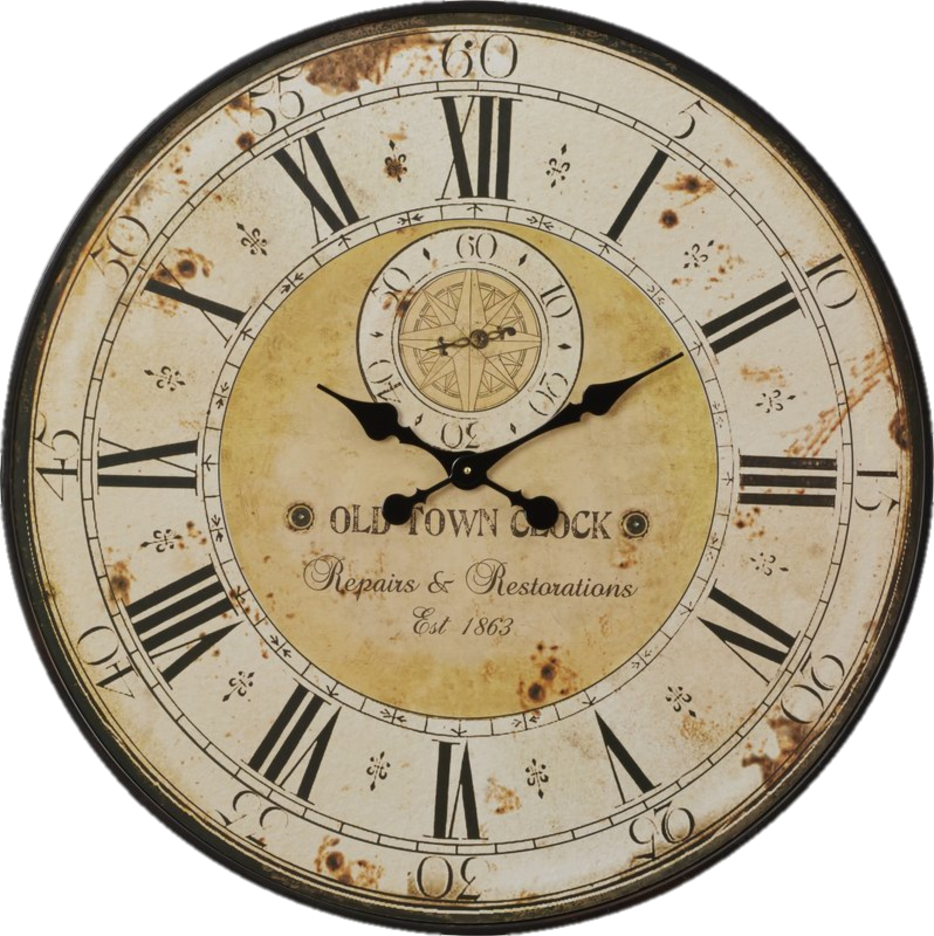
Modular Arithmetic

Slide 49
Modular Arithmetic

Slide 50
The abelian group of prime residue classes modulo q
*
: = { a mod q : gcd(a,q) = 1 }
Examples
q=7
*
(q-1)
q=20
*

Slide 51
Characters
These are 1-d representation of the residue class group
There are as many characters as many elements, i.e. ϕ(q)
These arithmetic functions satisfy a series of properties

Slide 52
Characters
.
.

Slide 53
Dirichlet L-functions
Partition functions of free bosons with an extra
Z_{𝜑(q)} abelian charge

Slide 54
Dirichlet L-functions
The Riemann function is a very special case
of a Dirichlet function (q=1)

Slide 55


Slide 56
Generalised Riemann Hypothesis
(Piltz 1884)
The non-trivial zeros of ALL Dirichlet functions
(i.e. for any modulus q and any character)
are ALL along the critical line placed at

Slide 57
The main idea of our argument
The angles 𝜃(p_{n}) are computed along the sequence of the primes p_{n}

Slide 58
The main idea of our argument
If α=1/2, i.e.
then all zeros are on the critical line!

Slide 59
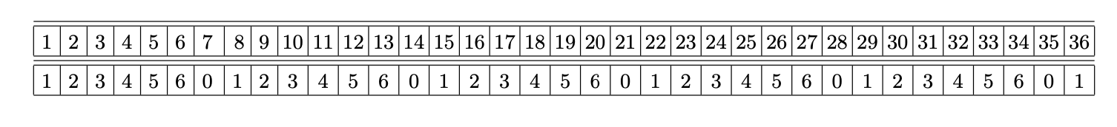
q = 7
2
3
5
4
6
3
5
2
1
3

Slide 60
4, 6, 3, 5, 2, 1, 3, 2, 6, 1, 5, 4, 3, 5, 4, 1, 3, 2, 6,
5, 6, 3, 5, 2, 4, 1, 1, 5, 4, 6, 2, 4, 3, 2, 6, 5, 4, 6, 2, 4, 1, 3,

Slide 61
Properties of the series B(N)

Slide 63
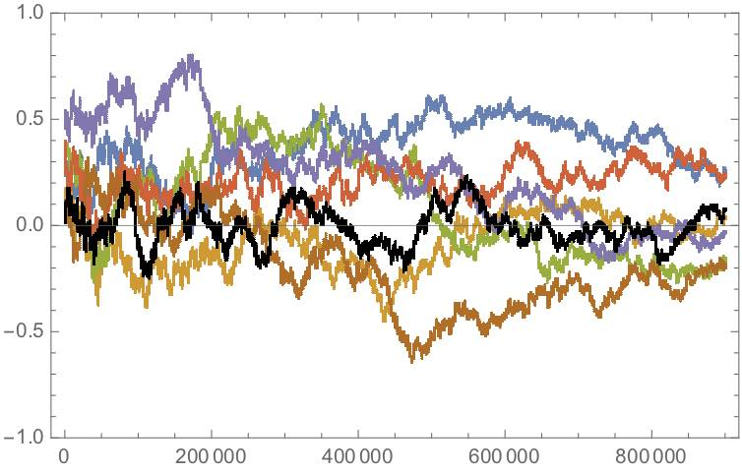

Slide 64
Properties of the series B(N)
All its terms are of the same order (order 1)
no Levy flights!
All the angles are equiprobable (Dirichlet theorem)

Slide 65
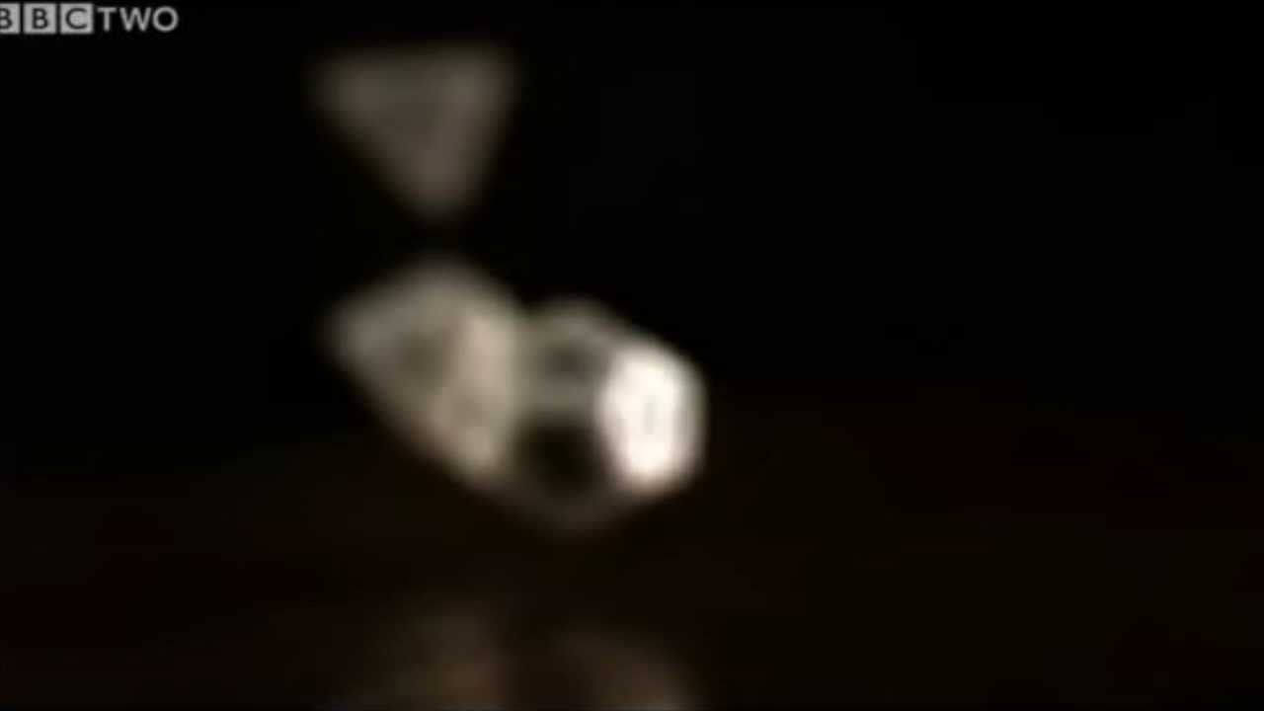

Slide 66
Properties of the series B(N)
All terms are of the same order (order 1)
All the angles are equiprobable (Dirichlet theorem)
As consequence, the mean of the series B(N) vanishes

Slide 67
Properties of the series B(N)
All terms are of the same order (order 1)
All the angles are equiprobable (Dirichlet theorem)
As consequence, the mean of the series B(N) vanishes
The variable c_{n} are very weakly correlated

Slide 68
As a matter of fact, we have a very clear idea of
all their correlations!
(Lemke Oliver-Soundararajan)

Slide 69
As a matter of fact, we have a very clear idea of
all their correlations!
(Lemke Oliver-Soundararajan)

Slide 70
As a matter of fact, we have a very clear idea of
all their correlations!
(Lemke Oliver-Soundararajan)
FOR LARGE N,
THE RESIDUES ARE UNCORRELATED !!!

Slide 71
Deterministic Random Time Series
B(N) grows as a brownian motion !

Slide 72
Law of iterated logarithms
(Khinchin –Kolmogorov)
For a brownian motion we have to control the tails

Slide 73
Experimental Mathematics
All previous considerations lead to conclude
Can we falsify such a conclusion ?
But, can we actually check or disprove it ?

Slide 74
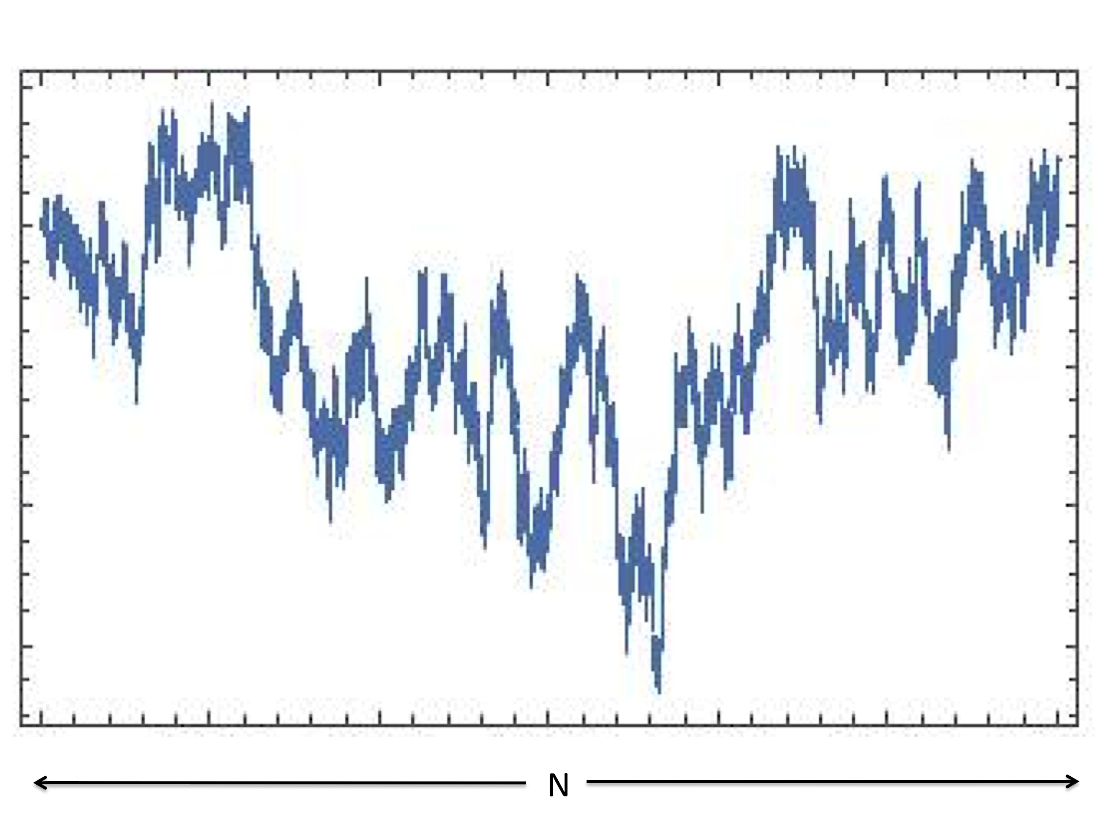
Deterministic Random Time Series

Slide 75
Deterministic Random Time Series

Slide 76
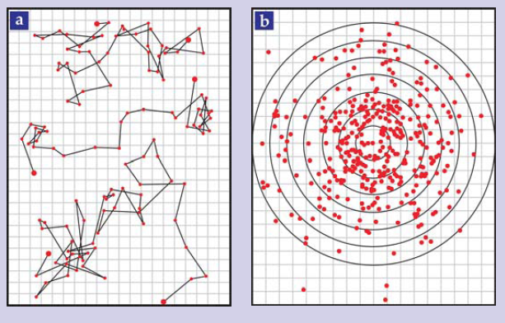
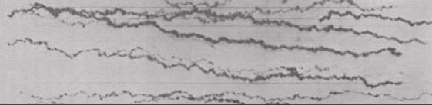
Jean Perrin (1908)
Ivar Nordlund (1914)
Notes:
Classical experiments by Jean Perrin (1908) Nobel Prize in Physics in 1926, pioneer for atomic view of nature. But few years later (1914) it was the Swedish physicist Ivar Nordlund who developed impressive experimental stroboscopic techniques the first to show that it is possible to extract robust quantitative analysis on the Brownian motion by taking record of sufficiently long trajectories without the need to do ensemble averaging. Kappler in 1931 refined further the tecnhiques and extract Avogadro’s number with precision of 1%.

Slide 77
Problem of single Brownian trajectory
We can use parts of the infinite time series to generate
the statistical ensembles!
With an abuse of language, the time series gives rise to
its own “thermal bath”

Slide 78
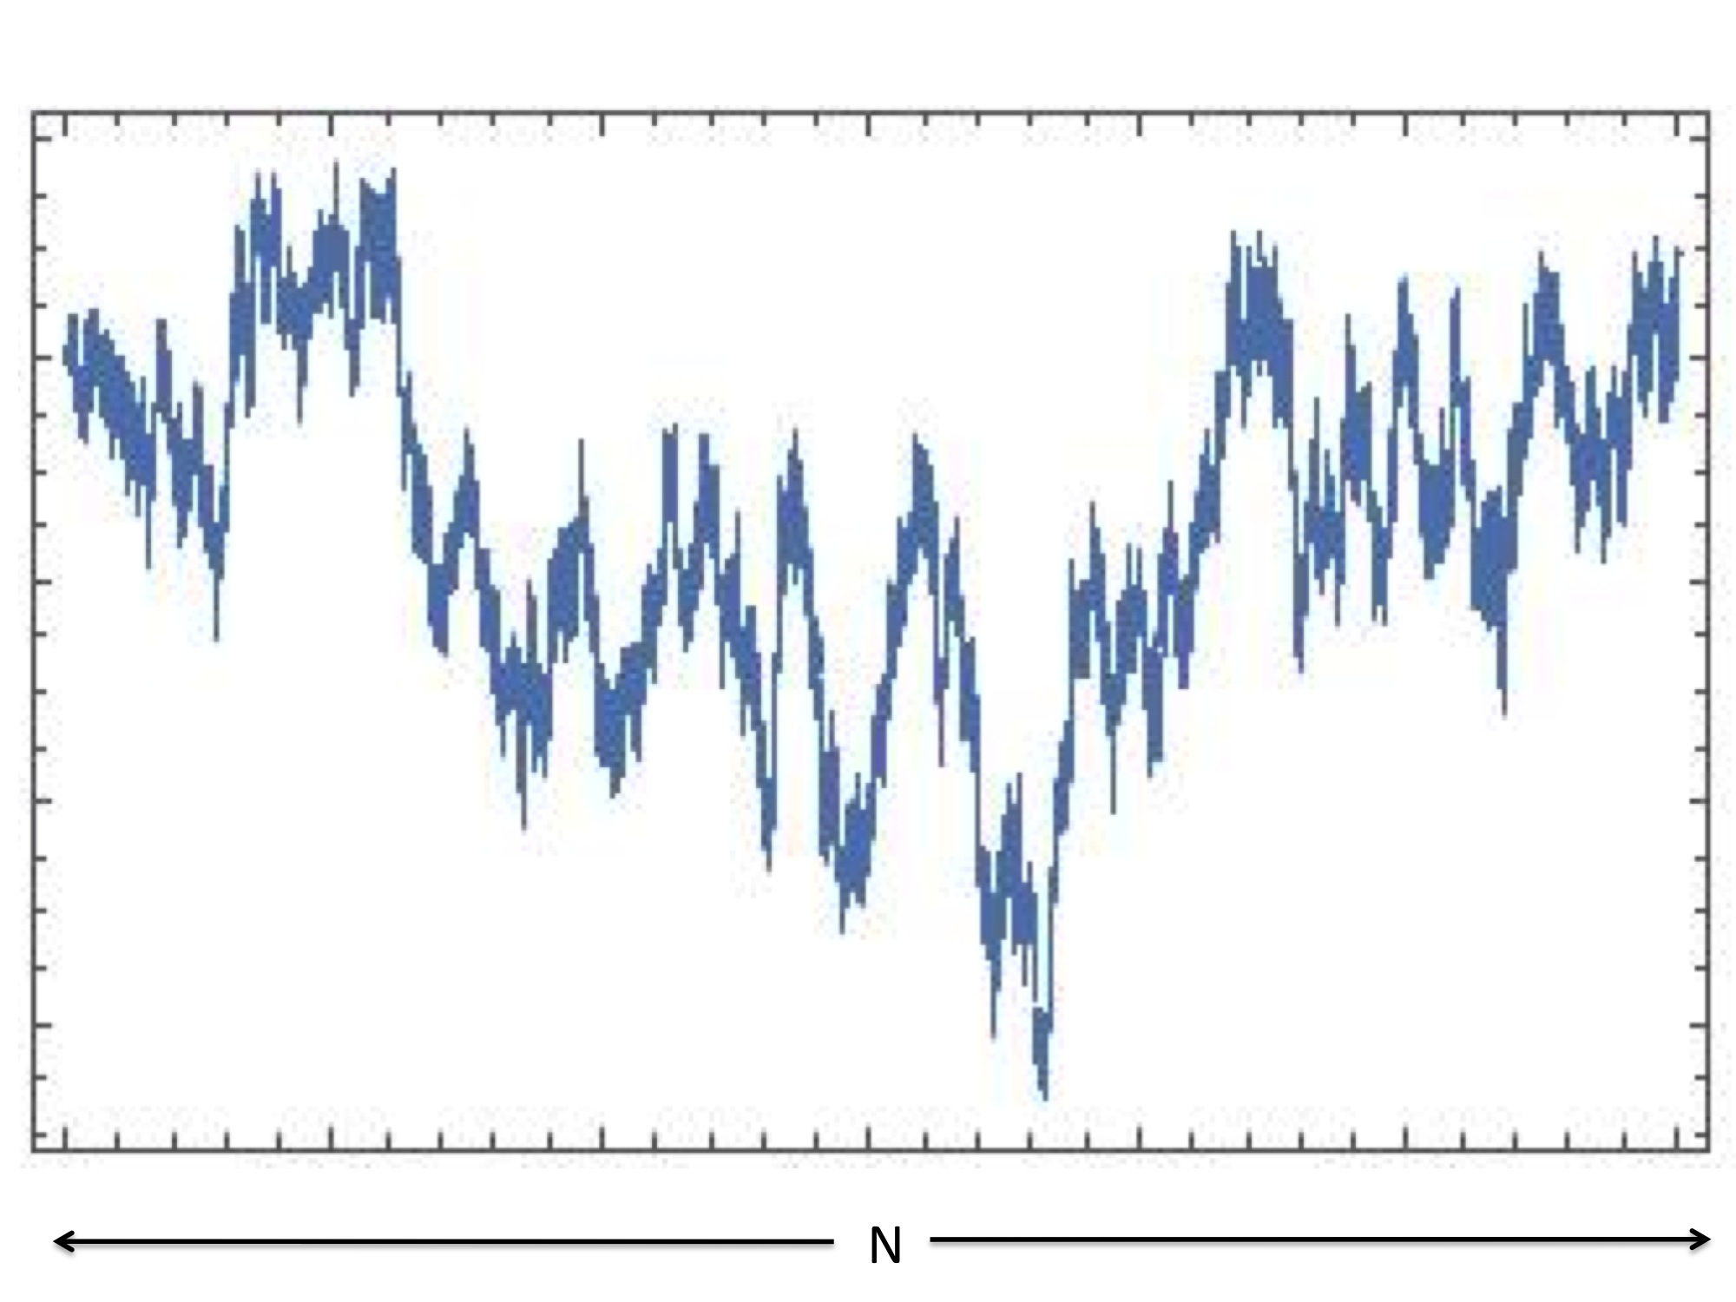

Slide 79
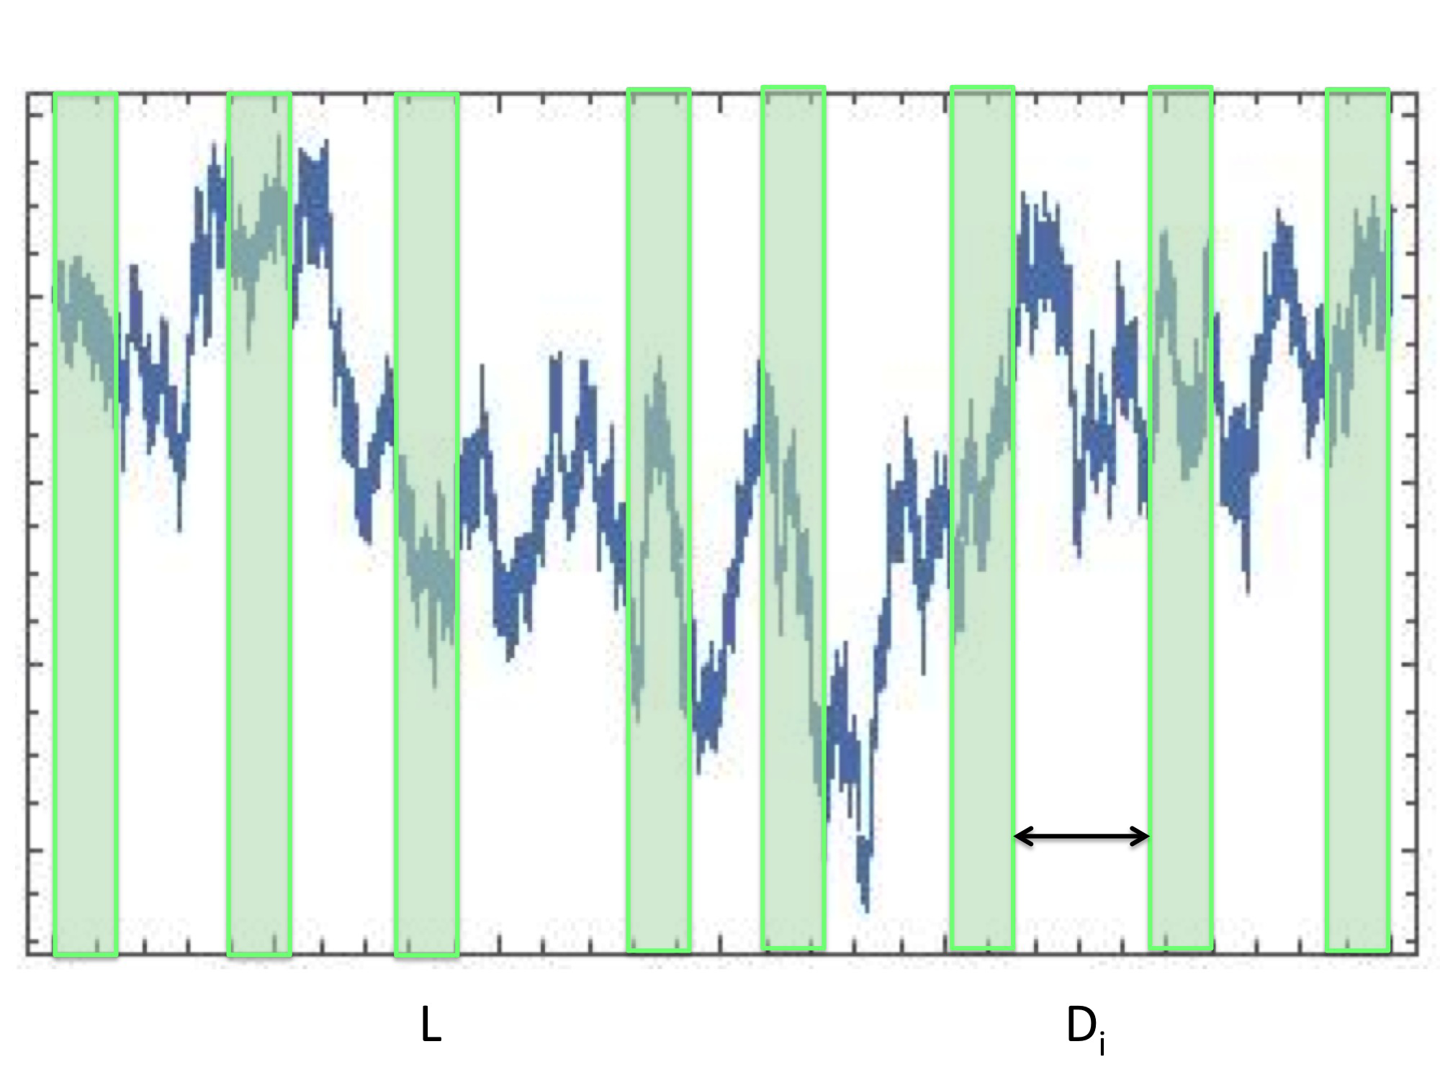

Slide 83
Block Variables

Slide 84
If the original series goes as
the same should happen for any of its subsets!

Slide 85
Huge battery of highly sophisticate statistical tests
Longest run of positive values
Matrix rank test
Discrete Fourier Transform distribution
Min-max time distribution
Entropy test
Cumulative sum test
Random excursion test
… … …

Slide 86
Min-max distribution

Slide 87
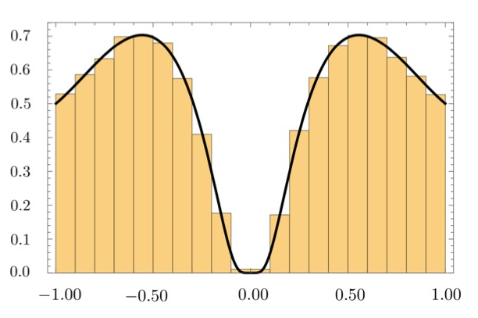
(Mori, Majumdar, Schehr, 2019)

Slide 88
Pearson 𝜒² = 31.12 with d = 35 degrees of freedom
P-value = 0.77
Kolmogorov-Smirnov test ➔ 99.99%

Slide 89
To Whom the Bell Tolls: Universal distribution of Mertens Function

Slide 90
Singularity of the Mellin Transform of L-functions
The integral is then singular at σ =1/2
Namely, all zeros are on the critical line!

Slide 91
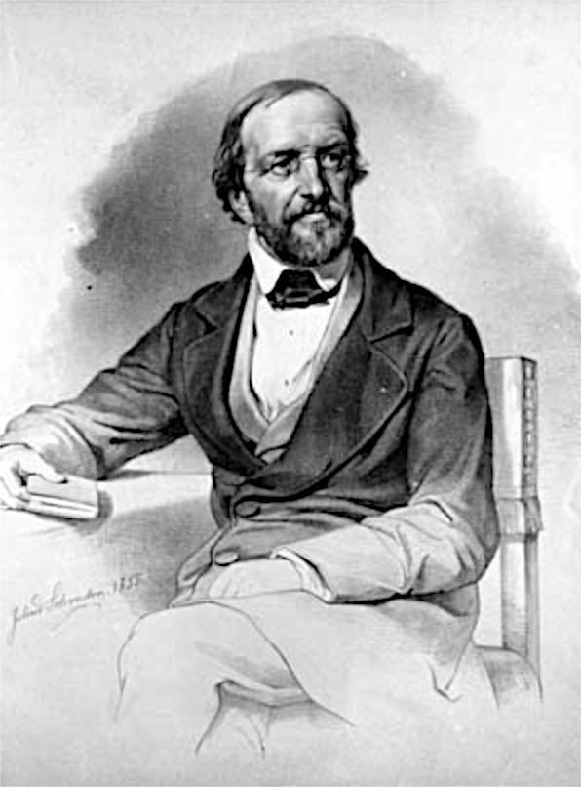
Conclusions
There are infinitely many functions which, as the Riemann
zeta function, has all their zeros along Re(s) = 1/2
This properties can be traced back to some
random properties of the primes
The validity of the GRH relies on probability theorems
involving the residues and the absence of their correlations
Hence, the (Generalised) Riemann Hypothesis is just
“Random Walk theorem” !!!

