Slide 1
Integrable Quantum Field Theories and Quantum Electronic Circuits
Ananda Roy
Rutgers University
The art of mathematical physics, CEA Saclay
09/20/2021

Slide 2

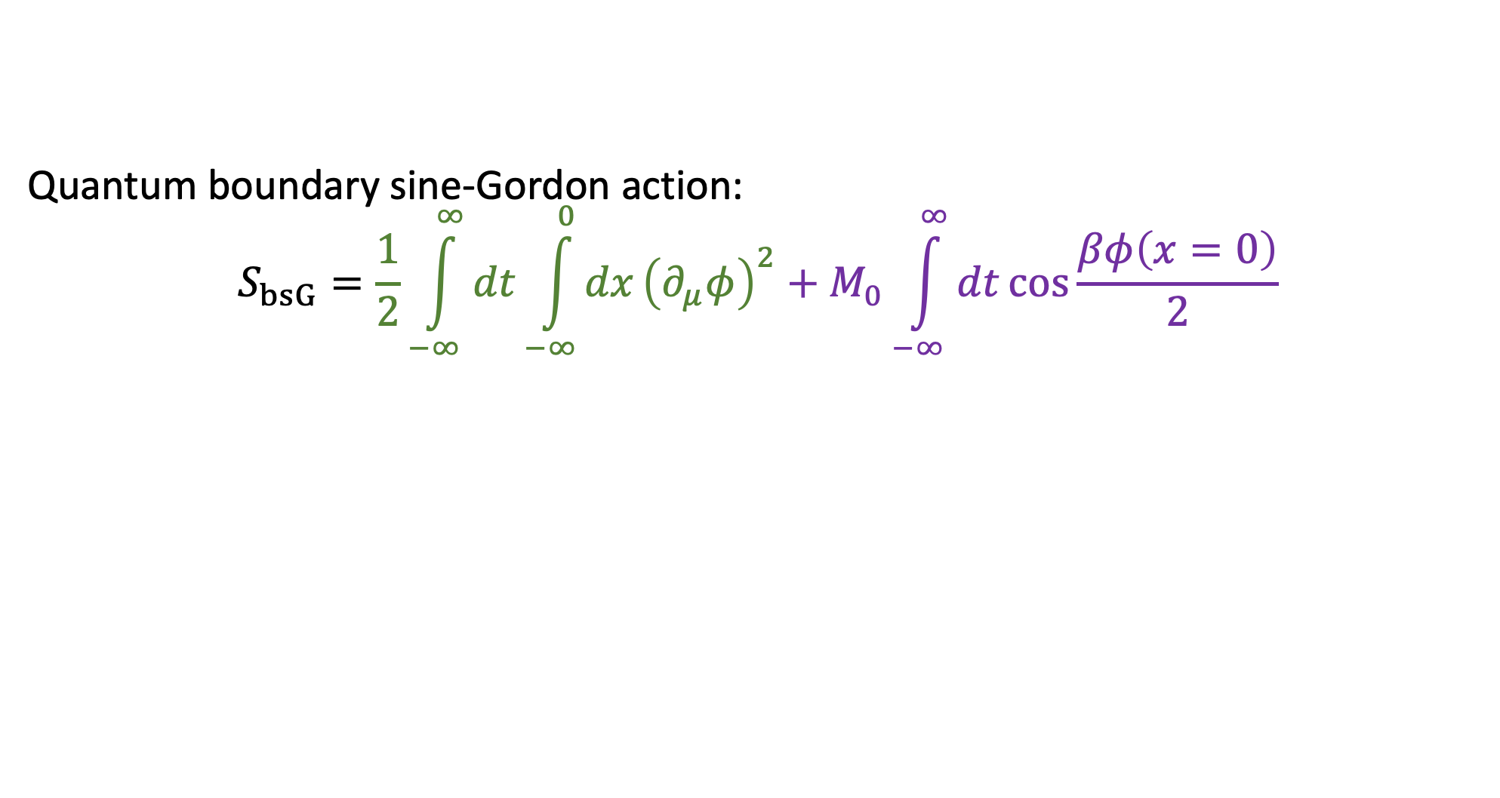


The quantum boundary sine-Gordon model and a few of its physical realizations
Quantum boundary sine-Gordon action:
$$S_{bsG}=\frac{1}{2}\int_{−∞}^{∞}{dt}\int_{−∞}^{0}{dx}{\left(∂_{μ}φ\right)}^{2}+M_{0}\int_{−∞}^{∞}{dt}\cos{\frac{βφ\left(x=0\right)}{2}}$$
Ghoshal and Zamolodchikov
(1994), Saleur et al (1995)
free, compact
boson
Integrable boundary
perturbation
Fractional quantum hall systems
Quantum Electronic
Circuits
Quantum spin chains
experimentally realizable
customizable
numerically tractable
…
spin $\frac{1}{2}$
$$H_{XXZ}=−\sum_{i}{\left(σ_{i}^{x}σ_{i+1}^{x}+σ_{i}^{y}σ_{i+1}^{y}+Δ_{i}σ_{i}^{z}σ_{i+1}^{z}\right)}$$
$$H_{bdry}=−λ_{0}σ_{0}^{x}$$
Fendley et al (1995), H. Saleur (1998)
A.R. and H. Saleur (2019, 2020)
Lukyanov (1997, 1999)

Slide 3









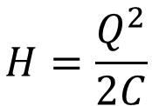


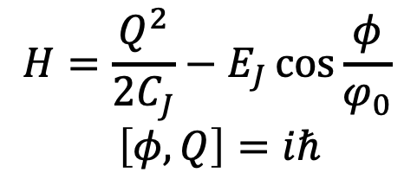




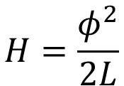

Essential quantum electronic circuit elements
electric
charge
magnetic
flux
magnetic flux
electric charge
electric currents
$$φ$$
$$I_{1}$$
$$I_{2}$$
$$φ$$
$$L$$
$$+Q$$
$$+Q$$
$$C$$
$$≡$$
$$C_{J}$$
$$E_{J}$$
$$M$$
$$−Q$$
$$−Q$$
Inductor
Capacitor
Mutual Inductor
Josephson junction
$$H=\frac{Q^{2}}{2C_{J}}−E_{J}\cos{\frac{φ}{φ_{0}}} \\ \left[φ,Q\right]=iℏ$$
$$H=\frac{φ^{2}}{2L}$$
$$H=\frac{Q^{2}}{2C}$$
$$H=−MI_{1}I_{2}$$
$$φ_{0}=ℏ/2e$$
Caldeira and Leggett (1983), Devoret (1997)
Notes:
In order to do this, we will need two more circuit elements, in addition to the capacitor and a Josephson junction. An inductor … and a mutual inductor… .
*Go a bit fast here*
While these are very familiar elements from electrical circuit theory, I want to emphasize that here they are quantum elements – where objects like magnetic flux, electric currents and charges are quantum operators.

Slide 4
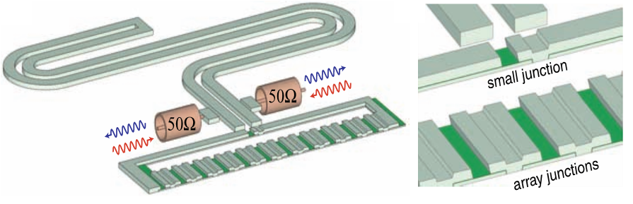
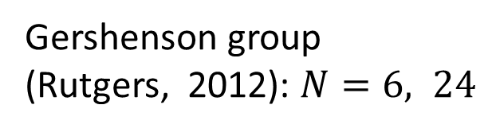

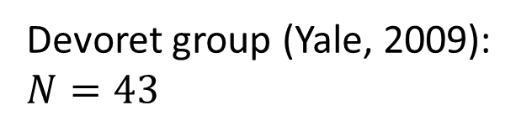


Motivated by experiments
Devoret group (Yale, 2009):
$N=43$
Gershenson group (Rutgers, 2012): $N=6, 24$
Esteve-Joyez group (Saclay, 2013):
$$N∼100$$
Roch group (Grenoble , 2019): $N∼1500$
Manucharyan group (Maryland, 2018, 2019): $N∼33000$
Probing strongly-interacting
quantum many-body systems
Early experiments: Delft (1990-s), early theory: Callan and Thorlacius (1990)
Notes:
The history of many-body physics experiments with quantum circuits goes back to the pioneering works in Delft in the 1990-s. However, the field has undergone a revolution in the recent years with the recent works on Josephson junction arrays. One of the first works was at Yale in the Devoret group where they analyzed an array of 43 JJ-s. There was work in the Gershenson group at Rutgers in 2012, where they analyzed arrays of 6 and 24 junctions. Then there was more progress in the Esteve group in Saclay where they analyzed arrays of about 100 junctions. In the recent years, there has been JJ arrays of 1500 junctions in the Roch group in Grenoble. Even more recently, in the group of Vladimir Manucharyan in Maryland, arrays of up to 33000 junctions have been built. I want to emphasize that these are not arrays of qubits, which would be difficult to realize due to the finite lifetimes. Rather, we are seeing engineered quantum environments being built to probe strongly interacting many-body systems.

Slide 5
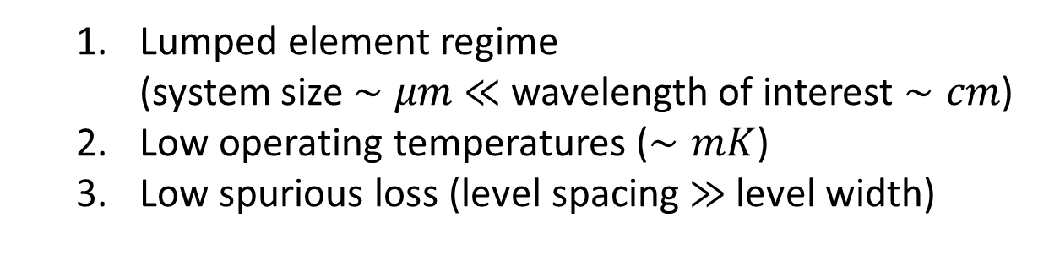





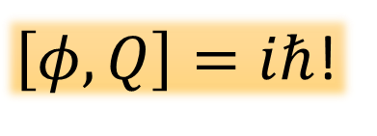
When is it okay to quantize?
magnetic flux
$$φ$$
electric charge
$$L$$
$$+Q$$
$$C$$
$$−Q$$
Inductor
Capacitor
  Lumped element regime
  (system size $∼μm$ $≪$ wavelength of interest $∼cm$)
  Low operating temperatures ($∼mK$)
  Low spurious loss (level spacing $≫$level width)
$\left[φ,Q\right]=iℏ$!
Caldeira and Leggett (1983), Devoret (1997)

Slide 6
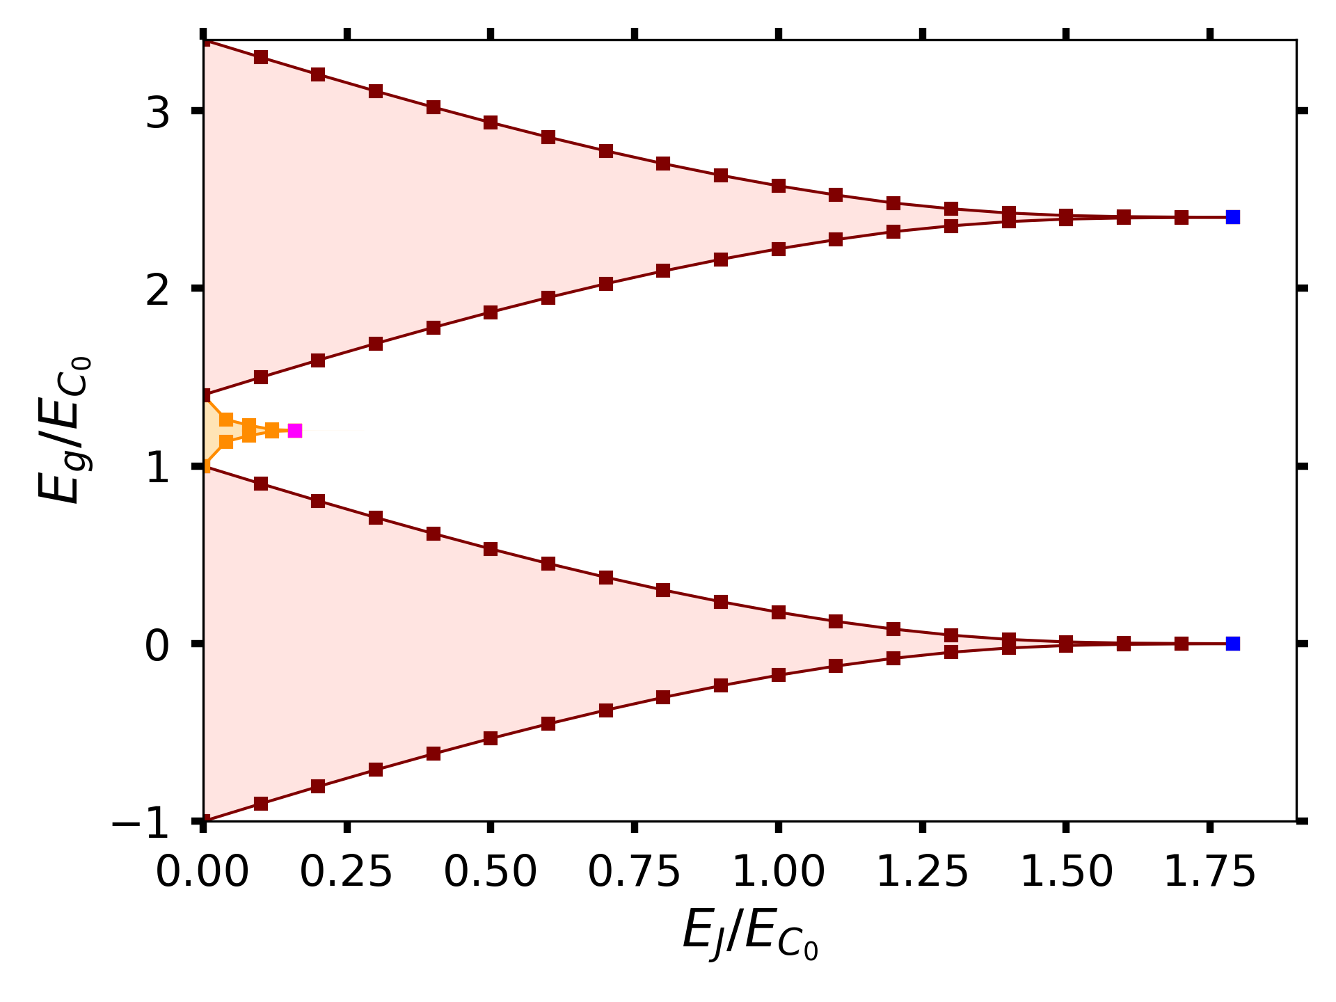
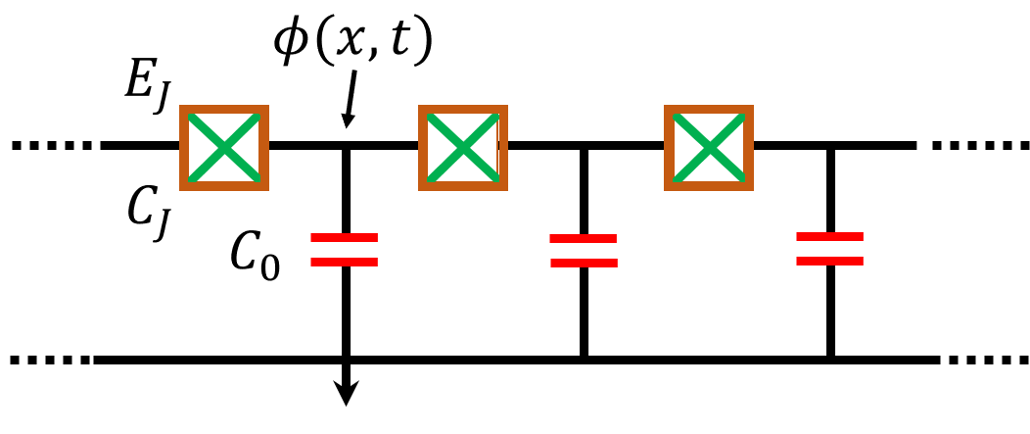


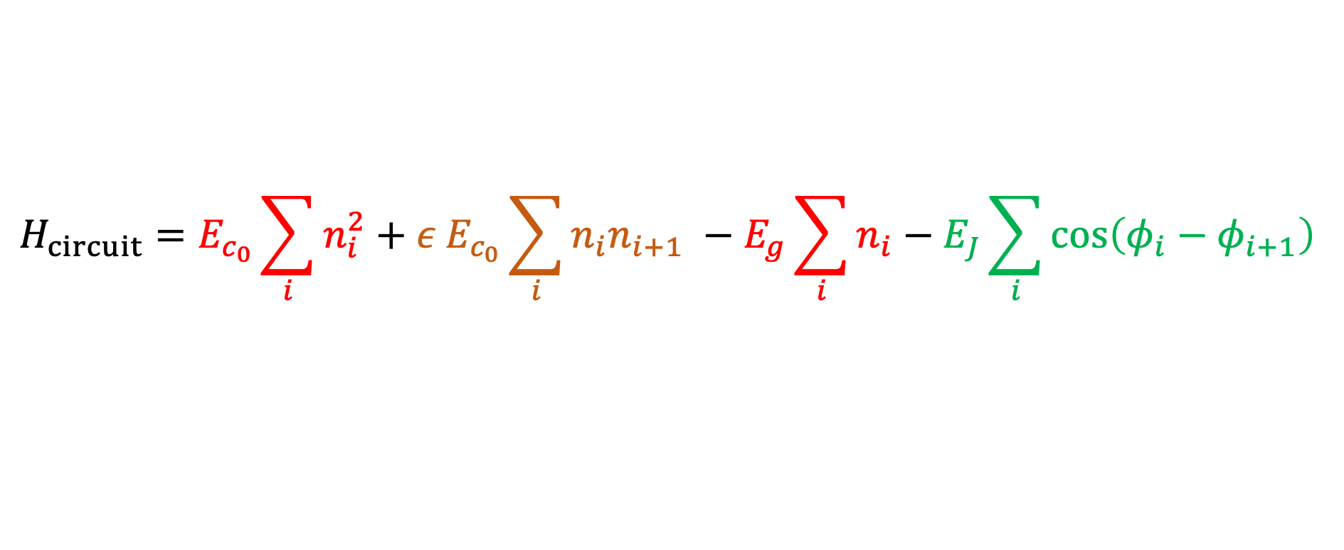




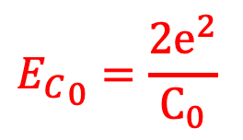

The Bose-Hubbard model with quantum circuits
Experimental Setup: Maryland group (2018)
DMRG results
$ρ=1$ Mott Ins.
Luttinger liquid
(free massless boson)
Quantum circuit, first step: without disorder
$ρ=\frac{1}{2}$ charge-density-wave
$${E_{C}}_{0}=\frac{2e^{2}}{C_{0}}$$
$\sim$High T
$ρ=0$ Mott Ins.
$\sim$low T
$ε<1$
$$H_{circuit}=E_{c_{0}}\sum_{i}{n_{i}^{2}}+{ε E}_{c_{0}}\sum_{i}{n_{i}n_{i+1}} −E_{g}\sum_{i}{n_{i}}−E_{J}\sum_{i}{\cos\left(φ_{i}−φ_{i+1}\right)}$$
Quantum Hamiltonian for 2D XY model
nearest-neighbor hopping
onsite repulsion
nearest-neighbor repulsion
`chemical potential’
$$\left[n_{i},e^{±iφ_{j}}\right]=±e^{±iφ_{j} }δ_{ij}$$
AR et al, J. Stat. Mech. (2020)
Bradley and Doniach (1984), Korshunov (1989), Bruder et al (1993), Glazman and Larkin (1997)
Notes:
The Hamiltonian for this circuit is given here. It is very similar to the Bose-Hubbard model with nearest neighbor repulsion. As a first step, we treat the model without any disorder. Each term in the Hamiltonian arises from a circuit element. The first is the charging energy of the capacitor, which is the onsite repulsion term. The second term is the nearest-neighbor repulsion term due to the capacitance of the JJ. The third term is the chemical potential term that would arise if there is a gate electrode at each island. Finally, there is nearest neighbor hopping which is simply the Cooper-pairs tunneling between neighboring islands. Here, the phase phi and the number operator n are canonically conjugate. Note that here ni is the excess number of Cooper pairs on each island and thus can be both positive and negative – which is different from the conventional bose-hubbard model.
While the phase-diagram had been analytically predicted previously using perturbative methods, quantitative predictions of the phase-diagram has not been done using numerical methods. Here, we present this result using DMRG. The phase-diagram has Mott insulating phases with different charge-densities on each islands as well as charge-density wave phases. Most importantly, the system can be in a Luttinger liquid phase, which is the phase of a free massless boson field.

Slide 7
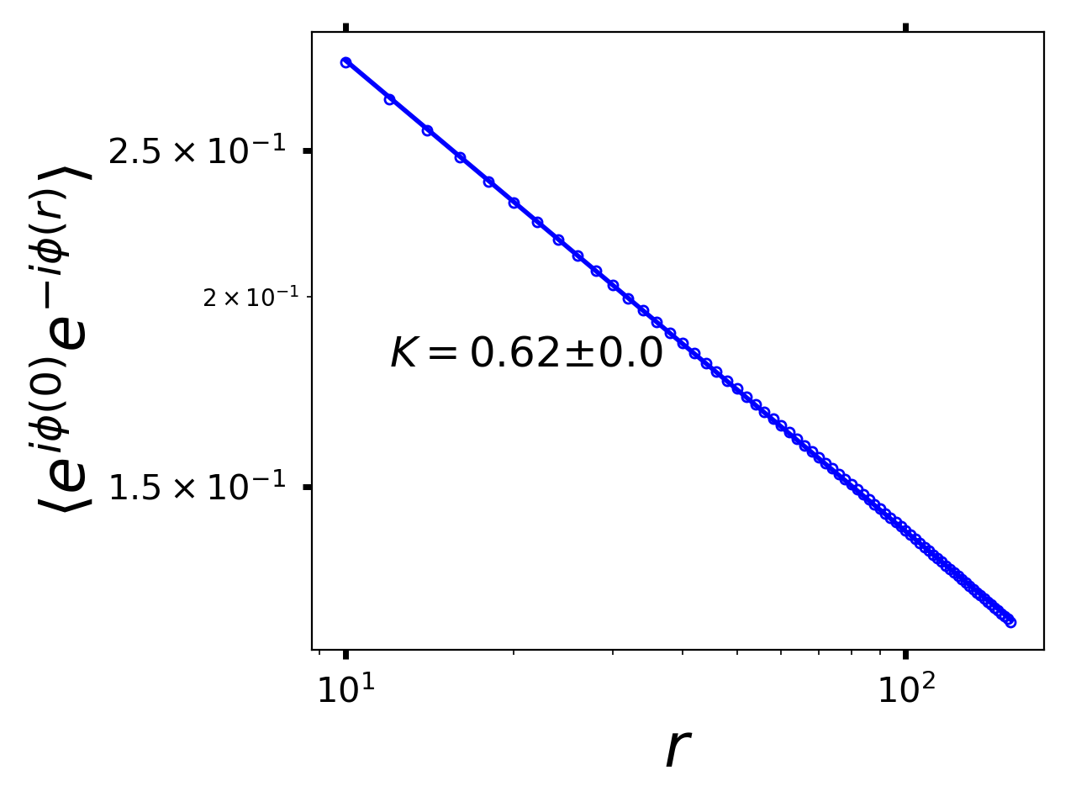
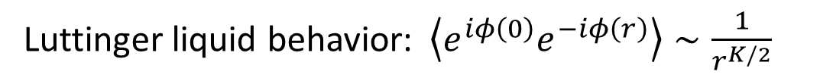


The Bose-Hubbard model with quantum circuits
DMRG results
Quantum circuit
$ρ=1$ Mott Ins.
Luttinger
Liquid
(free massless boson)
Luttinger liquid behavior:$\left\langle e^{iφ\left(0\right)}e^{−iφ\left(r\right)}\right\rangle ∼\frac{1}{r^{K/2}}$
$ρ=0$ Mott Ins.
Most experiments have disorder, the lobes are replaced by Bose-glass phase, but the Luttinger liquid (free boson) phase persists
Measurable in transport
characteristics across a weak-link:
Glazman and Larkin (1997),
Goldstein et al (2013)
AR et al, J Stat. Mech. (2020)
Notes:
In the Luttinger liquid phase, the correlation functions of the boson creation and annihilation operators exhibit algebraic decay, which is due to the gapless nature of the spectrum. This is shown here for a specific point in the phase-diagram, where we indeed see this algebraic decay. For this point, the Luttinger parameter is 0.62. I want to emphasize that most experiments have some amount of disorder. As a result, the lobes are replaced by the Bose glass phse, but the Luttinger liquid phase persists. This is the phase where the system is described by a free-massless-boson QFT and it is this phase that we are interested in.

Slide 8
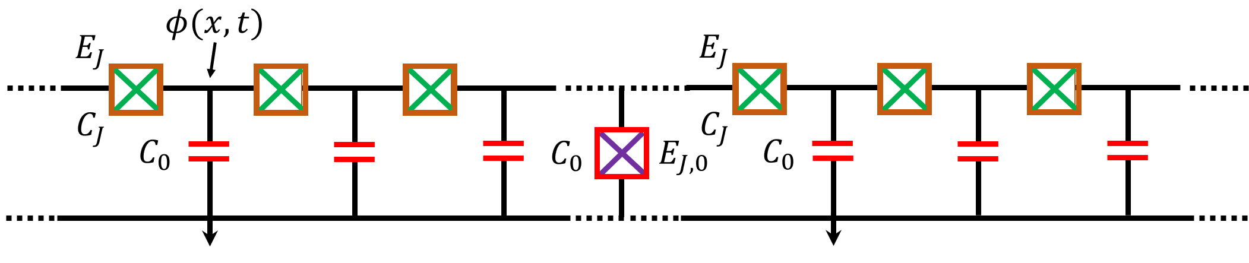


The free boson QFT with quantum circuits
Maryland group (2018, 2019): $N∼33000$
Grenoble group (2019): $N∼1500$
Quantum circuit
Quantum circuit
It is the tip of the iceberg…
Notes:
In this experiment, the Luttinger liquid phase was observed. On the right here, two such free-boson phases were coupled by an impurity. Then, it becomes a QED problem, where they measured Lamb shifts of the impurity. My goal here today is to show you that these experiments have only scratched the tip of the iceberg. Beyond the free boson phase, there lies a whole plethora of interesting QFT models that can be realized with quantum circuits.

Slide 9
An entanglement viewpoint
Free QFT
Massless boson
Integrable
QFT
Quantum sine-Gordon model
Perturbed
integrable QFT
Perturbed Quantum sine-Gordon model
Notes:
Last time, I already showed how these non-trivial QFTs could be realized with quantum circuits. This time, I want to show you how quantum circuits open investigation of entanglement properties of these QFTs.

Slide 10
An entanglement viewpoint
Free QFT
Massless boson
Integrable
QFT
Quantum sine-Gordon model
Perturbed
integrable QFT
Perturbed Quantum sine-Gordon model
Notes:
Last time, I already showed how these non-trivial QFTs could be realized with quantum circuits. This time, I want to show you how quantum circuits open investigation of entanglement properties of these QFTs.

Slide 11
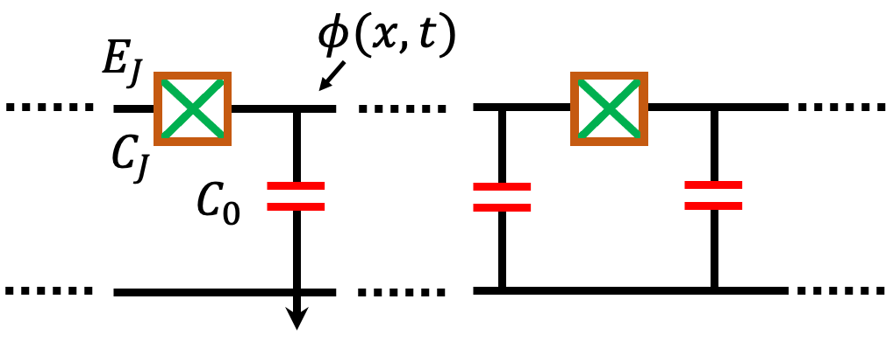


Entanglement in the free, massless boson QFT
Entanglement entropy:
$S=−Trρ_{A}\ln{ρ_{A}}, ρ_{A}={Tr}_{B}\left(ρ\right)$
Logarithmic scaling in the ground state:
$$S=\frac{c}{3}\ln{l}+S_{0}$$
Questions:
B
A
B
$$l$$
subsystem
size
Holzhey et al (1994),
Calabrese and Cardy (2004)
central
charge ( = 1 )
non-universal
1) Signature of the Luttinger
parameter in entanglement?
2) Entanglement in the
presence of boundaries?
3) Complete spectrum from
an entanglement measure?
conformal invariance allows exact analytical computations
Notes:
I showed before how to realize this field theory with circuits. One of the main questions for these many body states is entangkement and we want to understand deeply how that works. Using DMRG to calculate the entire spectrum.

Slide 12
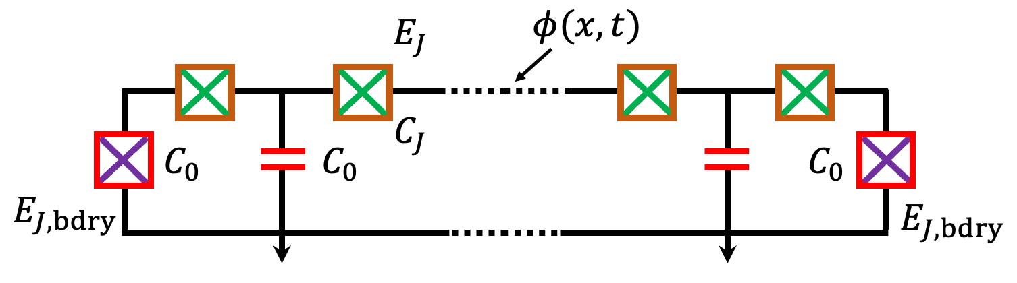
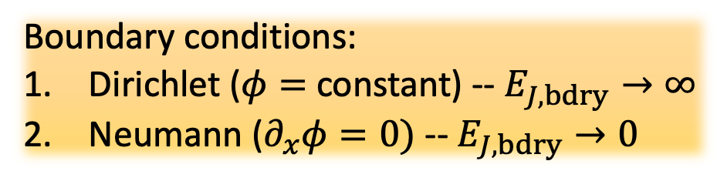



Entanglement in the free, massless boson QFT
$$L_{0}$$
Entanglement entropy:
$S=−Trρ_{A}\ln{ρ_{A}}, ρ_{A}={Tr}_{B}\left(ρ\right)$
Logarithmic scaling in the ground state:
$$S=\frac{c}{6}\ln{L_{eff }}+S_{b}+S_{0}$$
A
B
$$r$$
central
charge ( = 1 )
effective
subsystem
size
boundary
entropy
Boundary conditions:
Dirichlet ($φ=$ constant) -- $E_{J,bdry}→∞$
Neumann ($∂_{x}φ=0)$ -- $E_{J,bdry}→0$
non-universal
depends on
the Luttinger
parameter
Affleck and Ludwig (1991), Calabrese and Cardy (2004), see also: Lukyanov and Werner (2007)

Slide 13

Entanglement in the free, massless boson QFT
$$L_{0}$$
Entanglement entropy:
$S=−Trρ_{A}\ln{ρ_{A}}, ρ_{A}={Tr}_{B}\left(ρ\right)$
Logarithmic scaling in the ground state:
$$S=\frac{c}{6}\ln{L_{eff }}+S_{b}+S_{0}$$
Entanglement Hamiltonian: ${ ℋ}_{A}=−\frac{1}{2π}\ln{ρ_{A}}$
A
B
$$r$$
central
charge ( = 1 )
effective
subsystem
size
boundary
entropy
Boundary conditions:
Dirichlet ($φ=$ constant) -- $E_{J,bdry}→∞$
Neumann ($∂_{x}φ=0)$ -- $E_{J,bdry}→0$
non-universal
Accessible with DMRG, complements
exact diagonalization/truncated conformal
space approaches
spectrum gives the complete spectrum of the QFT
Haag (1992), Li and Haldane (2008), Cardy and Tonni (2016)

Slide 14
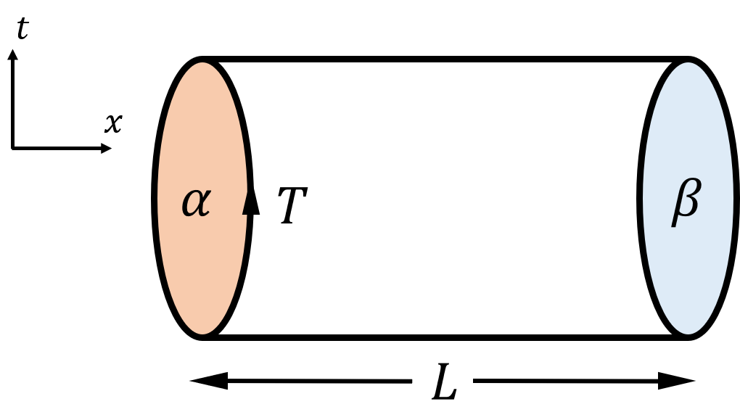
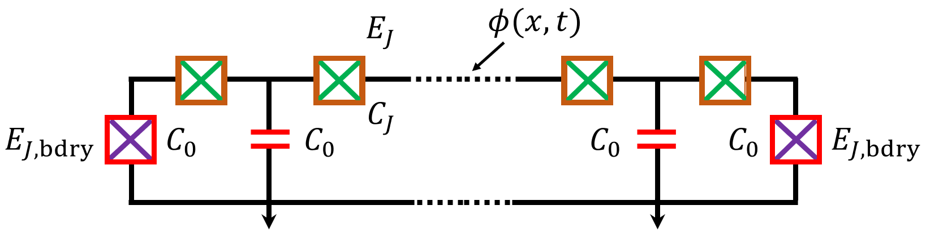





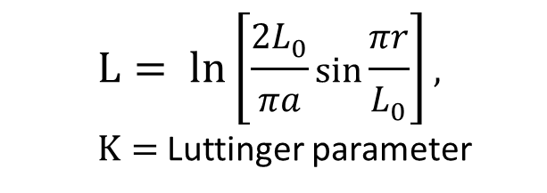

Entanglement spectrum of the free, massless boson QFT: exact results
$$L_{0}$$
Problem is the same as computing partition
function of boundary CFTs
Entanglement energy ($α=β=$ Neumann):
$ε_{N}\left(k,l\right)=ε_{N}\left(0,0\right)+\frac{π}{L}\left(\frac{K}{2}k^{2}+l\right)$,
degeneracy $p\left(l\right)=$# of integer partitioning of $l$
Change in boundary entropy (Neumann $→$ Dirichlet):
$ΔS_{N→D}=\frac{1}{2}\ln{\frac{2}{K}}$
$$α$$
$$α$$
$$β$$
A
B
exact form available
dim. of primary fields
descendant level
$$r$$
$$L= ln\left[\frac{2L_{0}}{πa}\sin{\frac{πr}{L_{0}}}\right],$$
$K=$ Luttinger parameter
AR et al, J. Stat. Mech (2020)
Related: DiGiulio and Tonni (2020), Giudici et al (2018)
Cardy (1984, 1989), Ishibashi (1988), Affleck and Oshikawa (1997)

Slide 15

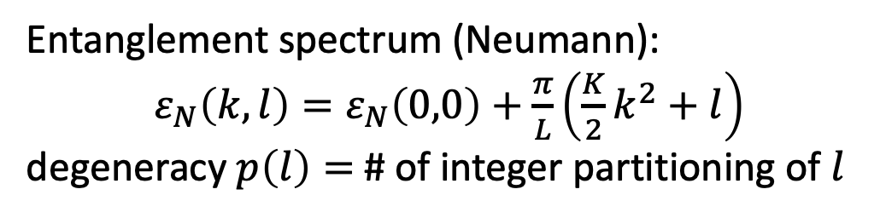

Entanglement in the free, massless boson QFT: DMRG vs exact results
Change in boundary entropy:
Neumann $→$ Dirichlet
$ΔS_{N→D}=\frac{1}{2}\ln{\frac{2}{K}}$
Entanglement spectrum (Neumann):
$ε_{N}\left(k,l\right)=ε_{N}\left(0,0\right)+\frac{π}{L}\left(\frac{K}{2}k^{2}+l\right)$
degeneracy $p\left(l\right)=$# of integer partitioning of $l$
total
system
size
subsystem size
AR et al, J. Stat. Mech (2020)
Luttinger parameter:$K=0.192$
Notes:
Why doing this calculation, switch S and spectrum, animate spectrum separately. While boundary CFTs have been studied before, the entanglement comptuations were not done before. It’s also relevant for experimentals stups which are finnite.

Slide 16


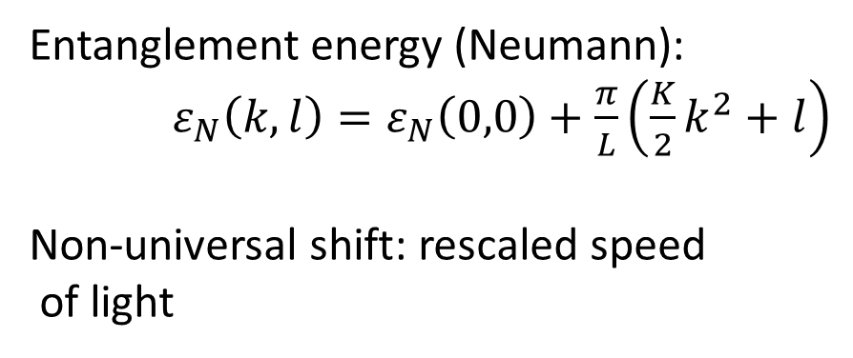

Entanglement spectrum of the 1+1 D free, compactified boson QFT: DMRG results
$$L_{0}=400$$
$$α$$
$$α$$
$$β$$
A
B
$$r=200$$
$$K=0.192$$
Entanglement energy (Neumann):
$ε_{N}\left(k,l\right)=ε_{N}\left(0,0\right)+\frac{π}{L}\left(\frac{K}{2}k^{2}+l\right)$
Non-universal shift: rescaled speed
of light
A.R. et al (2020)

Slide 17
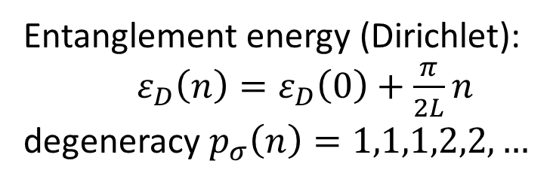
Entanglement spectrum of the 1+1 D free, compactified boson QFT: DMRG results
$$L_{0}=400$$
$$α$$
$$α$$
$$β$$
A
B
$$r=200$$
$$K=0.192$$
Entanglement energy (Dirichlet):
$ε_{D}\left(n\right)=ε_{D}\left(0\right)+\frac{π}{2L}n$
degeneracy $p_{σ}\left(n\right)=1,1,1,2,2,…$
A.R. et al (2020)

Slide 18









Conformal interfaces of quantum circuits
$$L$$
Entanglement in free, compactified massless boson:
$$S_{int}=\frac{c}{6}\ln{L_{eff}}+…$$
$$CFT_{A}$$
$$CFT_{B}$$
Trivial interface:
$$CFT_{A}=CFT_{B}$$
same central charge,
same compactification
radius
$$r$$
$$S_{int}$$
L = 400
$$c≃0.997 (1.0)$$
$$\ln{L_{eff}}$$
Bachas et al (2002, 2008), Sakai and Satoh (2008), AR and H. Saleur (unpublished)
Notes:
Supervising a master student workng on negatiivty, towards 2D field theory

Slide 19
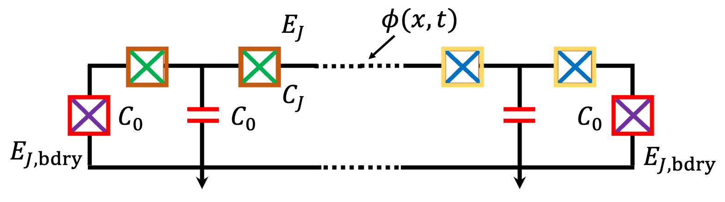




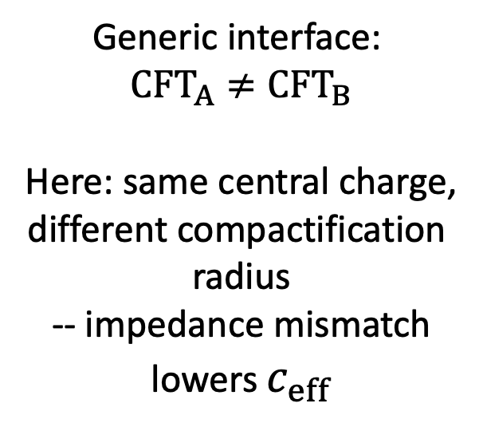

Conformal interfaces of quantum circuits
$$L$$
Entanglement in free, compactified massless boson:
$$S_{int}=\frac{c_{eff}}{6}\ln{L_{eff}}+…$$
$$E_{J,1}$$
$$E_{J,2}$$
$$CFT_{A}$$
$$CFT_{B}$$
Generic interface:
$$CFT_{A}≠CFT_{B}$$
Here: same central charge,
different compactification
radius
-- impedance mismatch
lowers $c_{eff}$
$$r$$
$$S_{int}$$
L = 400
$$c_{eff}≃0.975 (0.98)$$
$$c≃0.975 (0.98)$$
$$\ln{L_{eff}}$$
Bachas et al (2002, 2008), Sakai and Satoh (2008), AR and H. Saleur (unpublished)
Notes:
Supervising a master student workng on negatiivty, towards 2D field theory

Slide 20
Free QFT
Massless boson
Integrable
QFT
Quantum sine-Gordon model
Perturbed
integrable QFT
Perturbed Quantum sine-Gordon model

Slide 21
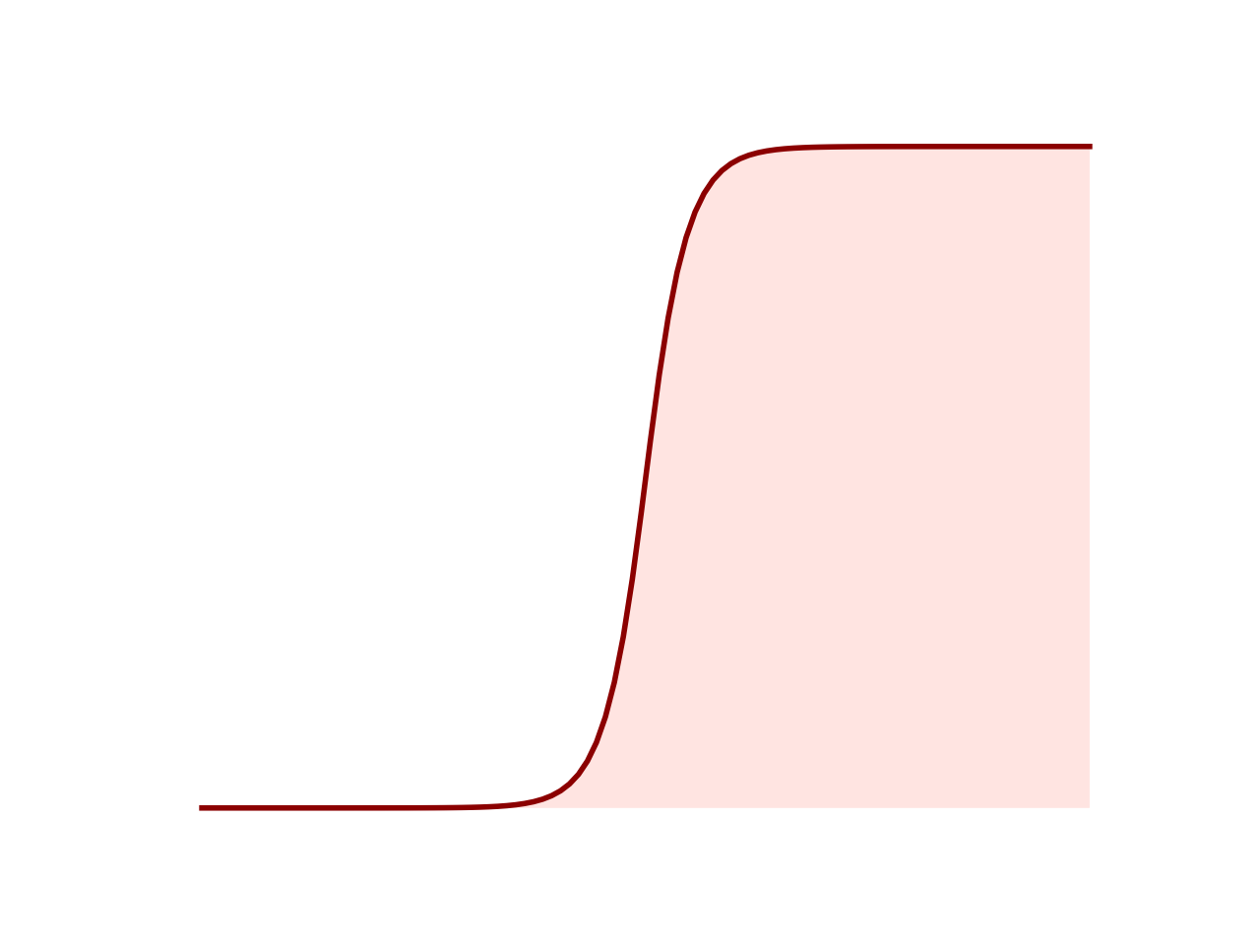
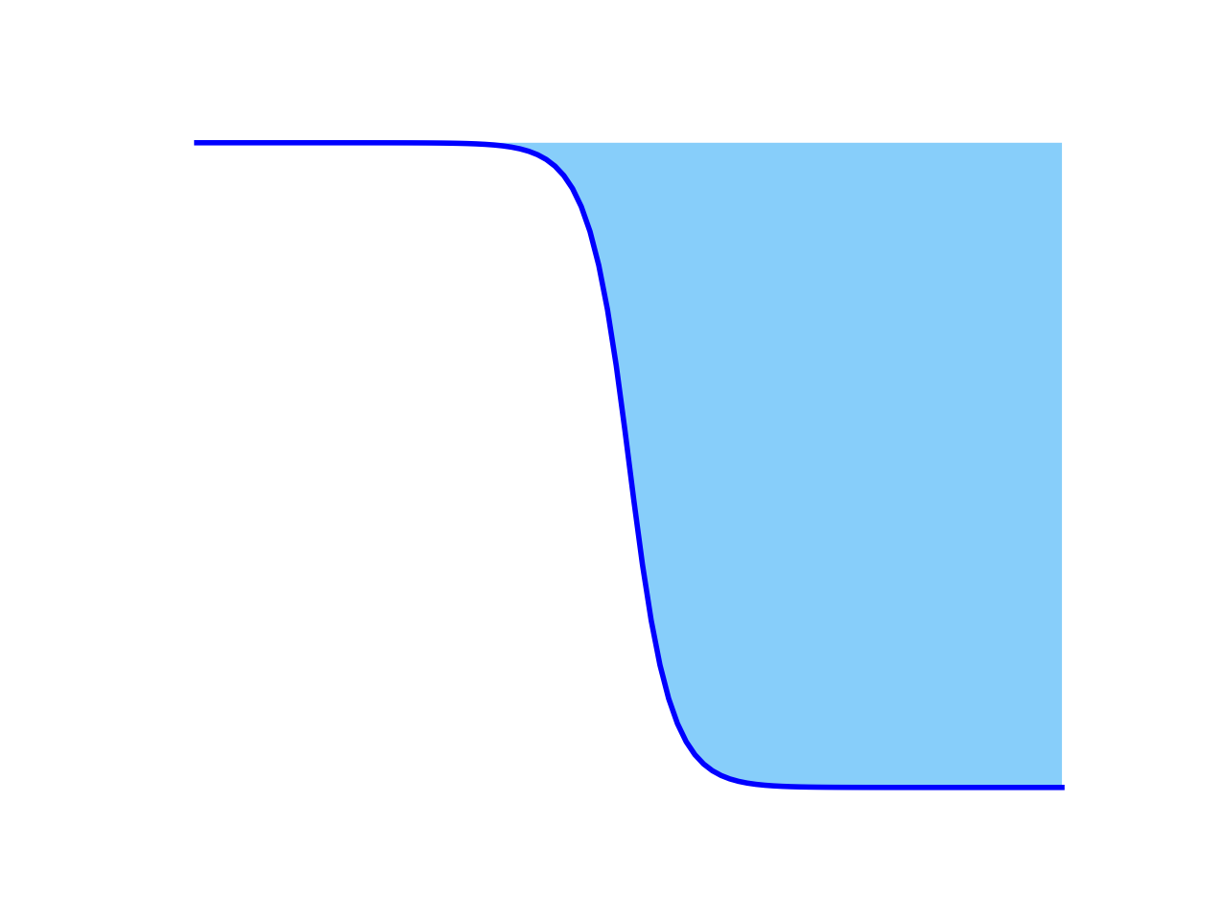
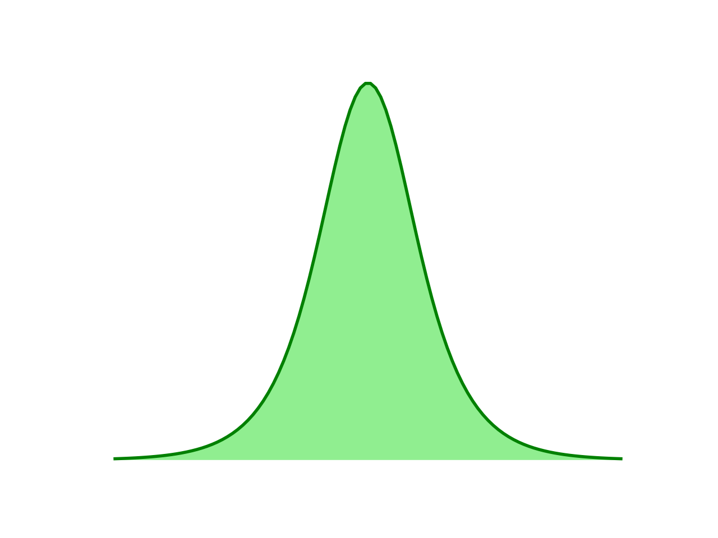
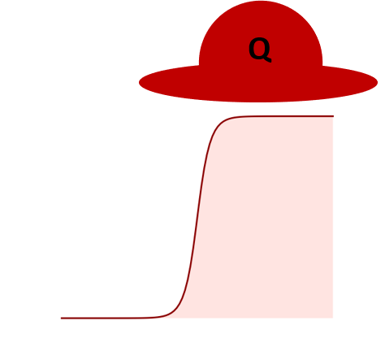
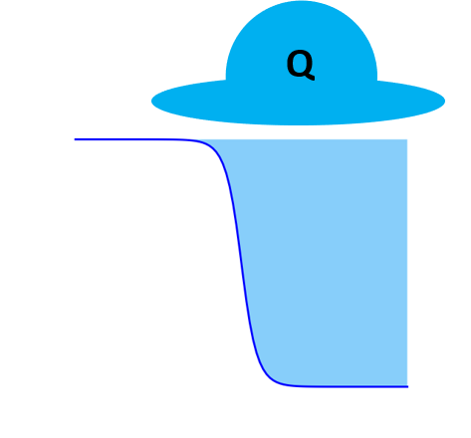
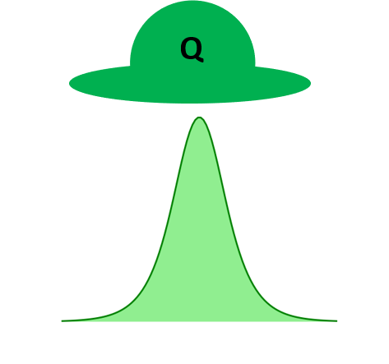

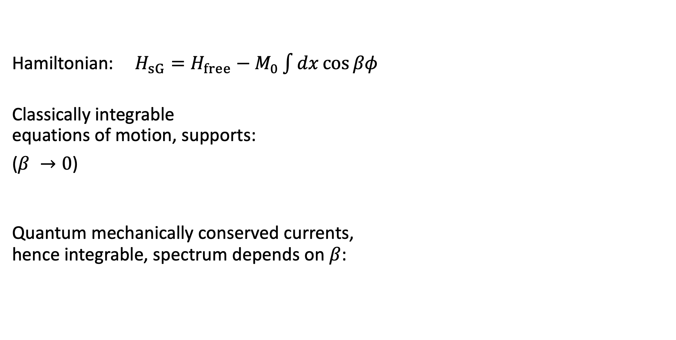


The quantum sine-Gordon model
Hamiltonian:$H_{sG}=H_{free}−M_{0}\int{dx\cos{βφ}}$
Classically integrable
equations of motion, supports:
($β →0$)
Quantum mechanically conserved currents,
hence integrable, spectrum depends on $β$:
soliton
antisoliton
breather
Allowed
particles
$$\frac{β^{2}}{8π}$$
$$1/2$$
$$1$$
Dashen et al (1975), Al. and A. Zamolodchikov (1979), Dennis and Bernard (1991)

Slide 22

From the free boson to the sine-Gordon model
Free boson model:
MI
Free
boson
MI
$$E_{J},E_{C_{0}}≫E_{C_{J}},$$
$$E_{C_{0,J}}={2e}^{2}/C_{0,J}$$
MI = Mott insulator
AR et al, Nucl. Phys. B (2021)

Slide 23
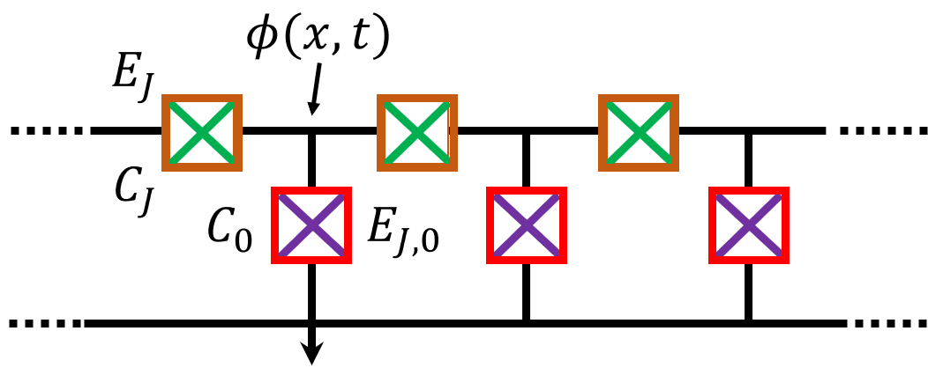
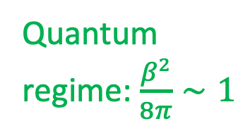
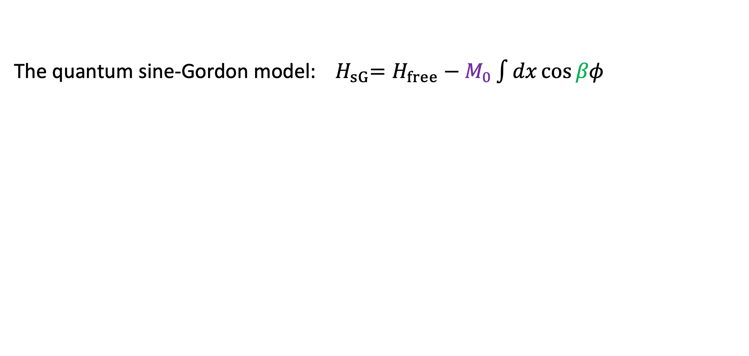


From the free boson to the sine-Gordon model
The quantum sine-Gordon model:${ H}_{sG}=H_{free}−M_{0}\int{dx\cos{βφ}}$
Quantum
regime: $\frac{β^{2}}{8π}∼1$
$$β=\sqrt{πK}$$
sine-Gordon
nonlinearity
$$E_{J},E_{C_{0}}≫E_{C_{J}},$$
$E_{J,0}∼E_{C_{0}}$
$$E_{C_{0,J}}={2e}^{2}/C_{0,J}$$
$$E_{J},E_{C_{0}}≫E_{C_{J}},$$
$$E_{C_{0,J}}={2e}^{2}/C_{0,J}$$
sine-Gordon
coupling
Luttinger
parameter
AR et al, Nucl. Phys. B (2021)

Slide 24


The quantum sine-Gordon model with quantum circuits
Quantum circuit:
Hamiltonian:
$$H_{circuit}=E_{c_{0}}\sum_{i}{n_{i}^{2}}+{ε E}_{c_{0}}\sum_{i}{n_{i}n_{i+1}} −E_{J}\sum_{i}{\cos\left(φ_{i}−φ_{i+1}\right)}−E_{J,0}\sum_{i}{\cos{φ_{i}}}$$
$$\left[n_{i},e^{±iφ_{j}}\right]=±e^{±iφ_{j} }δ_{ij}$$
nearest-neighbor
repulsion
sine-Gordon
nonlinearity
onsite repulsion
nearest-neighbor hopping
Related work: Solitons in long Josephson junctions, Ustinov (1988), Walraff et al (2003)
AR et al, Nucl. Phys. B (2021)

Slide 25







The quantum sine-Gordon model with quantum circuits: analytic vs DMRG results
$${\left\langle e^{iβφ}\right\rangle }_{latt}∝{ \left(\frac{E_{J,0}}{E_{C_{0}}}\right)}^{ξ}$$
$${\left\langle e^{iβφ\left(0\right)}e^{−iβφ\left(r\right)}\right\rangle }_{latt}$$
$$\frac{β^{2}}{8π}=0.063$$
first breather mass
$$ξ=\frac{β^{2}}{8π−β^{2}}$$
No fit parameters
repulsive regime is also accessible
BKT point is more difficult…
expected
Zamolodchikov (1995), Lukyanov and Zamolodchikov (1996), AR et al , Nucl. Phys. B (2021)
Notes:
To show how well the lattice model describes the field theory – also tells us what kind of length scales are required to realize these systems in practice

Slide 26

The quantum sine-Gordon model: exact results
Expectation value of vertex operator (exact result):
$$\left\langle e^{iβφ}\right\rangle =\frac{\left(1+ξ\right)πΓ\left(1−\frac{β^{2}}{8}\right)}{16\sin{πξ}Γ\left(\frac{β^{2}}{8}\right)}{\left[\frac{Γ\left(\frac{1+ξ}{2}\right)Γ\left(1−\frac{ξ}{2}\right)}{4\sqrt{π}}\right]}^{2β^{2}−2}m_{b_{1}}^{2β^{2}}$$
Relationship between the mass parameter $\left(M_{0}\right)$ of the action and the mass $\left(M\right)$of the soliton:
$$M_{0}=\frac{2Γ(β^{2})}{πΓ\left(1−β^{2}\right)}{\left[M\frac{Γ\left(\frac{1+ξ}{2}\right)}{2Γ\left(\frac{ξ}{2}\right) }\right]}^{2−\frac{β^{2}}{4}}, m_{b_{1}}=2M\sin{\frac{πξ}{2}}, ξ=\frac{β^{2}}{8π−β^{2}}$$
Zamolodchikov (1995), Lukyanov and Zamolodchikov (1996)

Slide 27
Entanglement spectrum of the quantum sine-Gordon model : DMRG results
Predicted degeneracies:
1,1,1,2,2,3,4,…
Sources of discrepancies:
Finite-entanglement truncation in DMRG
Non-integrable lattice model
Exact solution for entanglement
spectrum from XYZ spin-chain
Cho, Ryu and Ludwig (2017),
Calabrese, Cardy and Peschel (2010),
AR et al, J. Stat. Mech (2020),
AR et al, Nucl. Phys. B (2021)
0
5
10
Notes:
Check the plot label

Slide 28


The sine-Gordon model with XYZ spin-chain
Baxter’s XYZ spin-chain
$$H_{XYZ}=−\frac{1}{2}\sum_{i=1}^{L}{\left[J_{x}σ_{i}^{x}σ_{i+1}^{x}+J_{y}σ_{i}^{y}σ_{i+1}^{y}+J_{z}σ_{i}^{z}σ_{i+1}^{z}\right]},J_{x}>J_{y}≥\left|J_{z}\right|$$
XYZ to sine-Gordon operator mapping: $σ^{+}∼e^{\frac{iβφ}{2}}$
The QFT predictions apply in the regime: $a≪ξ≪L$
$+⋯$
corrections to
scaling important
for finite systems!
lattice
spacing
correlation
length
system
size
Cold atomic simulators of XYZ spin chains exist!
Murmann et al (2015),…
Baxter (1982), Luther (1975), Lukyanov (1997, 2003)

Slide 29




Faithful simulation of the sine-Gordon model: quantum circuits vs XYZ spin chain
Quantum circuits start from compact, bosonic lattice degrees of freedom
Quantum circuits
XYZ chain
$$⟨e^{iβφ}⟩$$
$$\left\langle σ^{+}\right\rangle ∼⟨e^{iβφ/2}⟩$$
corrections to scaling!
$$E_{J_{0}}/2E_{C_{0}}$$
Strength of the
cosine potential
$$E_{J_{0}}/2E_{C_{0}}$$
AR et al, Nucl. Phys. B (2021)

Slide 30
sine-Gordon --- XYZ spin chain --- eight vertex model
The sine-Gordon model arises as a continuum limit of the XYZ chain
The XYZ chain is the ‘Hamiltonian limit’ of the 2D classical eight-vertex model
The reduced density matrix spectrum of the XYZ chain is given by the spectrum of the eight-vertex corner-transfer matrix – can be computed exactly
Luther (1976), Lukyanov (2003), Baxter (1982), Peschel et al (1999), Ercolessi et al (2010), A.R. et al (2020)

Slide 31



Entanglement spectrum of the sine-Gordon model: exact results
mass parameter of
sine-Gordon action, fixed $β$
Fixed: sine-Gordon mass, coupling ($β$)
entanglement
energies
$ε_{XYZ}=$ entanglement gap
A.R. et al (2020)

Slide 32
Entanglement gap of the sine-Gordon model: XYZ vs QEC
XYZ gives incorrect results
Both QEC and XYZ
give reasonble predictions
A.R. et al (2020)

Slide 33
Free QFT
Massless boson
Integrable
QFT
Quantum sine-Gordon model
Quantum double sine-Gordon model
classical + quantum
integrable
DMRG results
Perturbed
integrable QFT
Perturbed Quantum sine-Gordon model

Slide 34
Free QFT
Massless boson
Integrable
QFT
Quantum sine-Gordon model
Quantum double sine-Gordon model
classical + quantum
integrable
DMRG results
Perturbed
integrable QFT
Perturbed Quantum sine-Gordon model

Slide 35

The quantum double sine-Gordon model
Euclidean action:
$$𝒜_{dSG}= \int{d^{2}x\left[\frac{1}{2}\left\{{\left(∂_{μ}φ_{1}\right)}^{2}+{\left(∂_{μ}φ_{2}\right)}^{2}\right\}+\frac{2M_{0}}{π}\cos{α_{1}φ_{1}}\cos{α_{2}φ_{2}}\right]}$$
Exists conserved currents leading to factorized scattering
Two cases when the model is quantum integrable:
  Symmetric case: ${ α}_{1}=α_{2}$ --- also classically integrable
  Relevant case: $α_{1}^{2}+α_{2}^{2}=4π$ --- purely quantum integrable!
Occurs in spinful Luttinger liquids and in quantum circuits
Bukhvostov and Lipatov (1980), Fateev (1996), Lesage et al (1997, 1998), A.R. and H. Saleur (2019)

Slide 36



The quantum double sine-Gordon model
$α_{1}^{2}+α_{2}^{2}=4π$
Euclidean action:
$$𝒜_{dsG}= \int{d^{2}x\left[\frac{1}{2}\left\{{\left(∂_{μ}φ_{1}\right)}^{2}+{\left(∂_{μ}φ_{2}\right)}^{2}\right\}+\frac{2M_{0}}{π}\cos{α_{1}φ_{1}}\cos{α_{2}φ_{2}}\right]}$$
Solitons exist of fields $φ_{1,2}=\frac{α_{1}φ_{1}±α_{2}φ_{2}}{2\sqrt{π}}$, have a pair of quantum numbers which scatter independently
Factorized scattering matrix: $S= S_{p_{1}}⨂{ S}_{p_{2}}$
Bethe ansatz calculation at zero and nonzero temperature
pseudo-particles
Thermodynamic
Bethe ansatz
equations
physical
particles
A. R. and H. Saleur (2019)

Slide 37





The double sine-Gordon model with quantum circuits
Two coupled sine-Gordon models, coupled by $∂_{x}φ_{1}∂_{x}φ_{2}$ and $∂_{t}φ_{1}∂_{t}φ_{2}$
Rotated fields: $φ_{1,2}=\frac{α_{1}φ_{1}±α_{2}φ_{2}}{2\sqrt{π}}$
A.R. and H. Saleur (2019)

Slide 38

The double sine-Gordon model with quantum circuits
classical integrable manifold: two decoupled sine-Gordon models
Rotated fields: $φ_{1,2}=\frac{α_{1}φ_{1}±α_{2}φ_{2}}{2\sqrt{π}}$
A.R. and H. Saleur (2019)

Slide 39

The double sine-Gordon model with quantum circuits
quantum integrable manifold: two coupled sine-Gordon models
Rotated fields: $φ_{1,2}=\frac{α_{1}φ_{1}±α_{2}φ_{2}}{2\sqrt{π}}$
A.R. and H. Saleur (2019)

Slide 40
The double sine-Gordon model with quantum circuits
quantum integrable manifold: two coupled sine-Gordon models
A testbed for classical vs quantum integrability
--- signatures in transport and specific heat measurements
A.R. and H. Saleur (2019)

Slide 41
An entanglement viewpoint
Free QFT
Massless boson
Integrable
QFT
Quantum sine-Gordon model
Quantum double sine-Gordon model
classical + quantum
integrable
Perturbed
integrable QFT
Perturbed Quantum sine-Gordon model
Notes:
Last time, I already showed how these non-trivial QFTs could be realized with quantum circuits. This time, I want to show you how quantum circuits open investigation of entanglement properties of these QFTs.

Slide 42
An entanglement viewpoint
Free QFT
Massless boson
XXZ chain
Integrable
QFT
Quantum sine-Gordon model
XYZ chain
Perturbed
integrable QFT
Perturbed Quantum sine-Gordon model
Notes:
Last time, I already showed how these non-trivial QFTs could be realized with quantum circuits. This time, I want to show you how quantum circuits open investigation of entanglement properties of these QFTs.

Slide 43
An entanglement viewpoint
Free QFT
Massless boson
XXZ chain
Integrable
QFT
Quantum sine-Gordon model
XYZ chain
Perturbed
integrable QFT
Perturbed Quantum sine-Gordon model
Notes:
Last time, I already showed how these non-trivial QFTs could be realized with quantum circuits. This time, I want to show you how quantum circuits open investigation of entanglement properties of these QFTs.

Slide 44









Perturbed integrable QFTs with quantum circuits
A perturbed sine-Gordon model
An Ising phase-transition occurs as $M_{0}/M_{0}^{′}$ increases
Quantum circuit:
$$C_{0}$$
$$E_{J,0}$$
$$H_{psG}=H_{free}−M_{0}\int{dx\cos{βφ}}−M_{0}^{′}\int{dx\cos\left(2βφ+δ\right)}$$
$2e$ Josephson
junction
$$C_{1}$$
$$E_{J,1}$$
$4e$ Josephson
junction
Mussardo et al (2004),
Bajnok et al (2018)
AR (unpublished)

Slide 45



Perturbed integrable QFTs with quantum circuits
A perturbed sine-Gordon model
Quantum circuit:
$$C_{0}$$
$$E_{J,0}$$
$$H_{psG}=H_{free}−M_{0}\int{dx\cos{βφ}}−M_{0}^{′}\int{dx\cos\left(2βφ+δ\right)}$$
$2e$ Josephson
junction
$\frac{Φ_{0}}{2}$
$$C_{1}$$
$$E_{J,1}$$
$4e$ Josephson
junction
Doucot, Ioffe et al (2001),
Brooks et al (2013),
Bell et al (2018),
Larsen et al (2020)
Potentially generalizable
to arbitrary interactions
AR (unpublished)
Gershenson group, Rutgers (2008)

Slide 46

An entanglement viewpoint
Free QFT
Massless boson
XXZ chain
Integrable
QFT
Quantum sine-Gordon model
XYZ chain
XYZ chain + $h\sum_{i}{σ_{i}^{x}}$
Perturbed
integrable QFT
Perturbed Quantum sine-Gordon model
Notes:
Last time, I already showed how these non-trivial QFTs could be realized with quantum circuits. This time, I want to show you how quantum circuits open investigation of entanglement properties of these QFTs.

Slide 47




Outlook: quantum quenches with quantum circuits
The sine-Gordon model:$H_{free}−M_{0}\int{dx\cos{βφ}}$
Quantum circuit:
Two possible quench scenarios by applying magnetic flux:
Quench in sine-Gordon coupling $β^{2}≃\frac{1}{2}\sqrt{\frac{2E_{C_{0}}}{E_{J}}}$
Quench in sine-Gordon mass parameter $M_{0}≃E_{J,0}/E_{C_{0} }$
$$Φ_{0}=\frac{h}{2e}$$
Tunable Josephson energy:
$$E_{J}\left({Φ }_{ext}\right)=E_{J}\left(0\right)\cos{\frac{πΦ_{ext}}{Φ_{0}}}$$
A.R. (unpublished)
Related analytical works: Bertini et al (2014), Rylands and Andrei (2019)

Slide 48



Outlook: beyond $c=1$
Boundary sine-Gordon action:
$$S_{bsG}=\frac{1}{2}\int_{−∞}^{∞}{dt}\int_{−∞}^{0}{dx}{\left(∂_{μ}φ\right)}^{2}+M_{0}\int_{−∞}^{∞}{dt}\cos{\frac{βφ\left(x=0\right)}{2}}$$
Boundary double sine-Gordon action:
$$S_{bdsG}=\frac{1}{2}\sum_{i=1,2}{\int_{−∞}^{∞}{dt}\int_{−∞}^{0}{dx}{\left(∂_{μ}φ_{i}\right)}^{2}}+M_{0}\int_{−∞}^{∞}{dt}\cos{\frac{β_{1}φ_{1}\left(x=0\right)}{2}}\cos{\frac{β_{2}φ_{2}\left(x=0\right)}{2}}$$
Ghoshal and Zamolodchikov
(1994), Saleur et al (1995)
Bukhvostov and Lipatov (1981), Fateev (1996),
Lesage et al (1997, 1998), Bazhanov et al (2016),
AR and H. Saleur, Phys. Rev. B (2019)
Conjectured nontrivial fixed point for $β_{1}^{2}+β_{2}^{2}=4π$
See also: Affleck et al (2001), Bachas et al (2002, 2008)

Slide 49


Outlook: beyond $c=1$
Boundary double sine-Gordon action:
$$S_{bdsG}=\frac{1}{2}\sum_{i=1,2}{\int_{−∞}^{∞}{dt}\int_{−∞}^{0}{dx}{\left(∂_{μ}φ_{i}\right)}^{2}}$$
$$+M_{0}\int_{−∞}^{∞}{dt}\cos{\frac{β_{1}φ_{1}\left(x=0\right)}{2}}\cos{\frac{β_{2}φ_{2}\left(x=0\right)}{2}}$$
Integrable manifold: $β_{1}^{2}+β_{2}^{2}=4π$
Trivial fixed point ($β_{1}^{2}+β_{2}^{2}≠4π)$:
$$\frac{g_{UV}}{g_{IR}}=\frac{1}{2}{\left(\frac{β_{1}^{2}}{8π}\frac{β_{2}^{2}}{8π}\right)}^{−\frac{1}{2}}$$
Double sine-Gordon fixed point ($β_{1}^{2}+β_{2}^{2}=4π)$: :
$$\frac{g_{UV}}{g_{IR}}={\left(\frac{β_{1}^{2}}{β_{1}^{2}+2π}\frac{β_{2}^{2}}{β_{2}^{2}+2π}\right)}^{−\frac{1}{2}}$$
$$\ln{g_{UV}/g_{IR}}$$
Free fermion
point
Integrable manifold
Lesage et al (1997, 1998), AR and H. Saleur (in progress)

Slide 50




Outlook: beyond $c=1$
boundary sine-Gordon model
boundary double sine-Gordon model
$$S_{bsG}=\frac{1}{2}\int_{−∞}^{∞}{dt}\int_{−∞}^{0}{dx}{\left(∂_{μ}φ\right)}^{2}$$
$$+M_{0}\int_{−∞}^{∞}{dt}\cos{\frac{βφ\left(x=0\right)}{2}}$$
$$S_{bdsG}=\frac{1}{2}\sum_{i=1,2}{\int_{−∞}^{∞}{dt}\int_{−∞}^{0}{dx}{\left(∂_{μ}φ_{i}\right)}^{2}}$$
$$+M_{0}\int_{−∞}^{∞}{dt}\cos{\frac{β_{1}φ_{1}\left(x=0\right)}{2}}\cos{\frac{β_{2}φ_{2}\left(x=0\right)}{2}}$$
AR and H. Saleur (in progress)

Slide 51
Thank You!
Johannes Hauschild (UC Berkeley)
Frank Pollmann (TU Munich)
Hubert Saleur (CEA Saclay)
Dirk Schuricht (Utrecht University)
Happy Birthday, Hubert!

Slide 52





Perturbed integrable QFT-s with quantum circuits
The massive Schwinger model
Quantum circuit:
$$𝒜_{mS}=\frac{1}{2}\int{dxdt \left[{\left(∂_{μ}φ\right)}^{2}−M_{0}\cos{βφ}−M_{0}^{′}φ^{2}\right]}$$
$$C_{0}$$
$$E_{J,0}$$
$2e$ Josephson
junction
$$L$$
a linear inductor, can
be a Josephson junction
array
A.R. (unpublished)

Slide 53

Towards supersymmetric integrable QFT-s with quantum circuits
$$C_{0}$$
$$E_{J,0}$$
The supersymmetric sine-Gordon model
Towards a quantum circuit:
$2e$ Josephson
junction
$$𝒜_{SuSy}=\frac{1}{2}\int{dxdt \left[{\left(∂_{μ}φ\right)}^{2}+\overline{ψ}γ_{μ}∂^{μ}ψ−M_{0}\cos{βφ}−M_{0}^{′} \overline{ψ}ψ\cos{\frac{βφ}{2}}\right]}$$
Majorana
Zero Modes
A.R. (unpublished)
Future work: DMRG analysis

Slide 54
Breaking free of 1+1 D
Kollar et al, Nature (2019)

